Slide 1
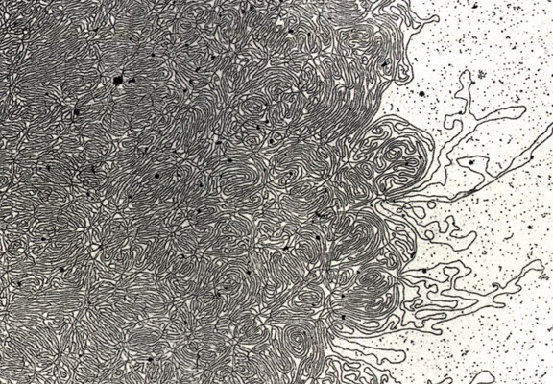
DNA- „Thread“

Slide 2
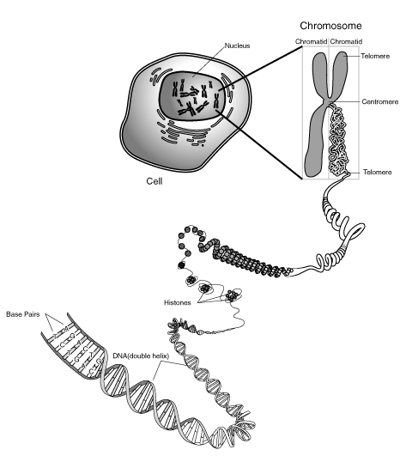
Notes:
Skin, muscle, and nerve cells are some examples of human somatic cells. They display a big variation in form and function, but all of them store their genetic information in the cell nucleus. Structures, called chromosomes, are the carriers of this information. They consist of a long, very thin „thread“ of DNA, in which this information is encoded.

Slide 3
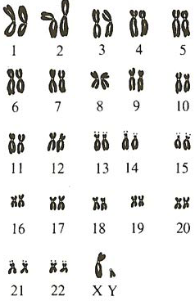
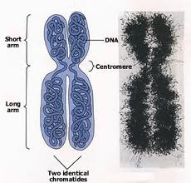

Slide 4
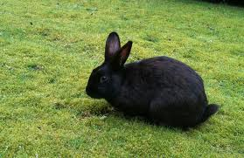
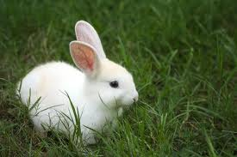
Rabbit Family Tree
? %
Notes:
Explain scheme
...let them try for some time!!!
Procedure:

Slide 5
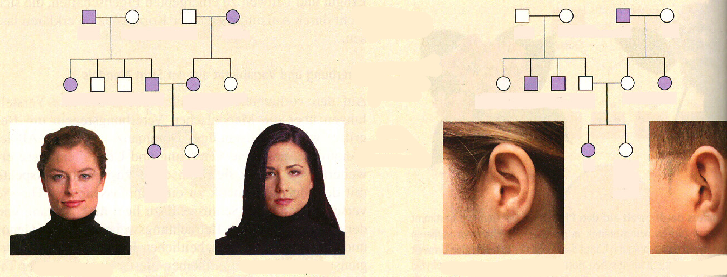
Dominant or Recessive?
1
2
3
4
1
2
3
4
5
6
7
8
9
10
5
6
7
8
9
10
11
12
11
12
Notes:
Explain: male/ female

Slide 6
dominant
recessive
1
2
3
4
1
2
3
4
Ww
ww
ww
Ww
Ff
Ff
ff
Ff
FF
5
6
7
8
9
10
or
5
6
7
8
9
10
Ww
ww
Ww
Ww
ww
ww
Ff
ff
ff
Ff
Ff
ff
11
12
11
12
WW
ww
ff
FF
or
or
Ff
Ww
W
w
f
F

Slide 7
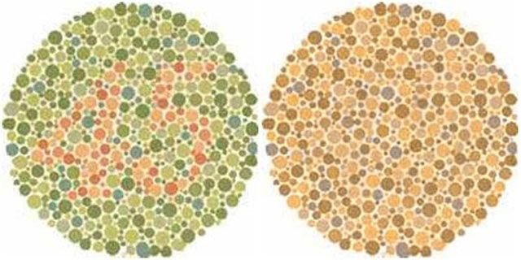
Colour Blindness
„normal vision“
„Colour blind“
Notes:
About 8 percent of males, but only 0.5 percent of females, are color blind… gene for normal functioning on the X-Chromosome!!!!
Not a problem to live with that. Not a disorder!

Slide 8
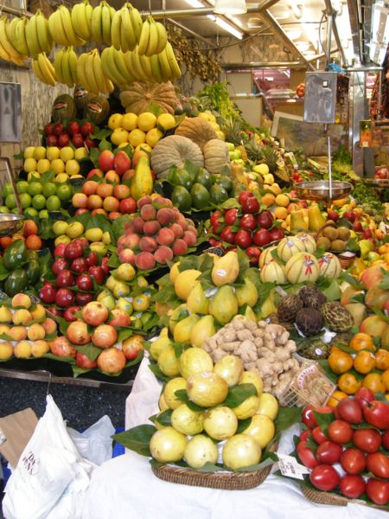
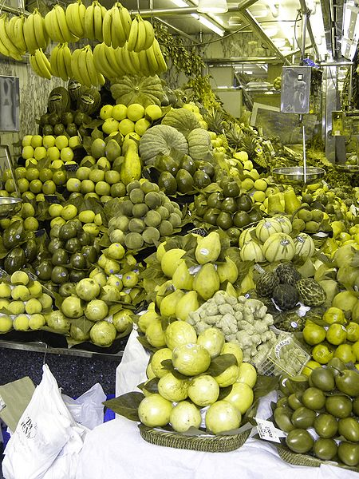
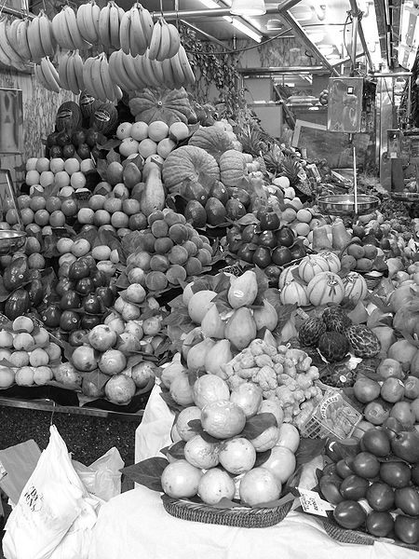
red or green receptors
missing
→„Dischchromatopsia“
no receptors for
colours → „black
and white“ vision
„normal“ vision
3 receptors
2 receptors
no receptor

Slide 9
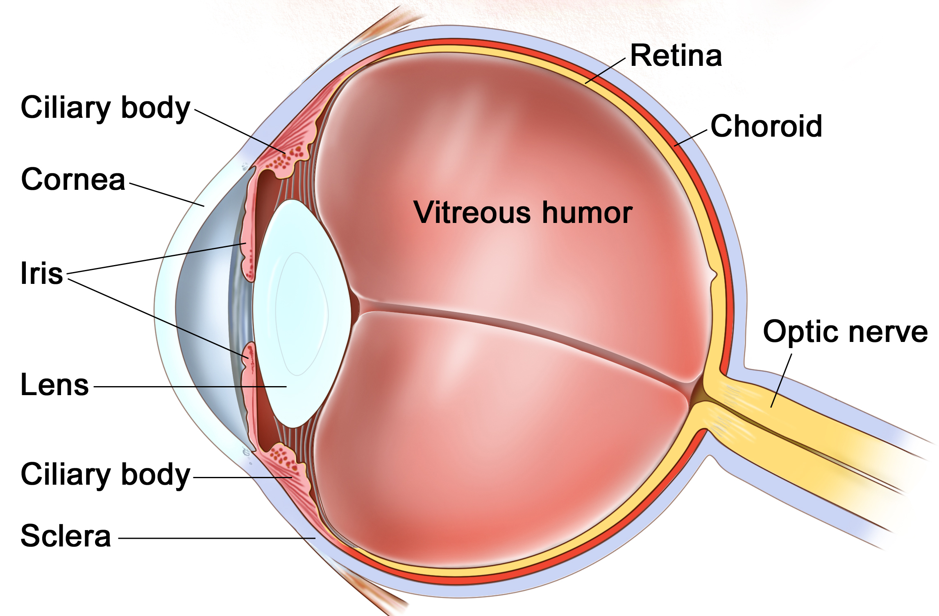
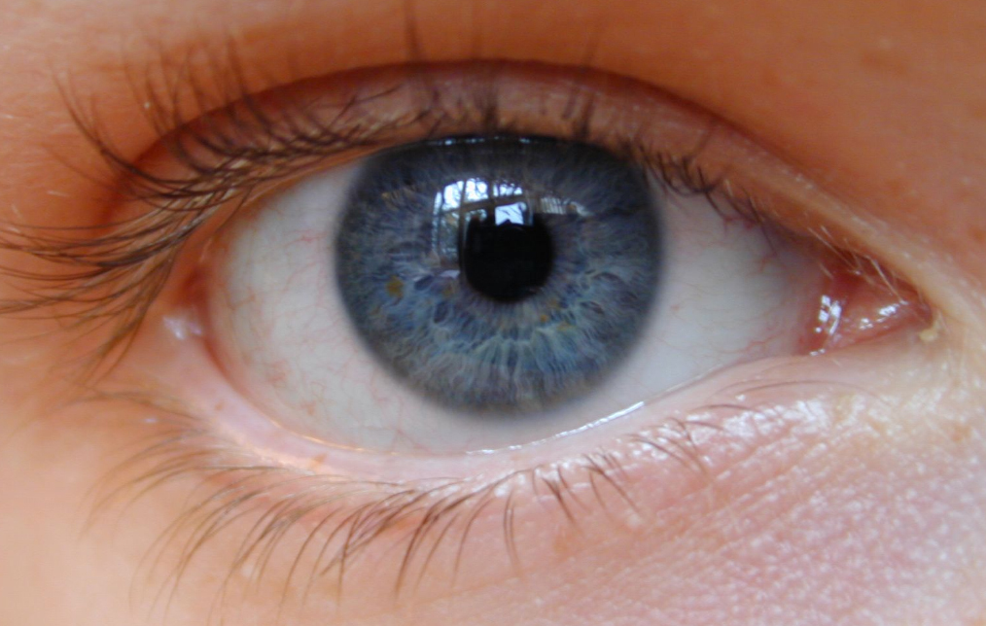
Anatomy of the Eye
Pupil
Blind spot
Notes:
Cornea / Lens Responsible for the Refraction/Bending of the light… adjustable bending is important to get a sharp image (later)
Refraction/ Bending→ show laser
(Change of medium→ change of direction)
show animation “the lens”
Iris / Pupil Eyecolour = Colour of the Iris.
Controls the amount of light entering the eye through the Pupil.
“Experiment”: Teamwork (1+1)
Other Person closes its eyes (ca. 10s.), then open…Other Person flashes with
the light into the eye.
Never flash into eyes with a laser pointer!(damaging the retina)
What happened? → Pupil got smaller.
Much Light entering… Reflex (you cannot deliberately control this): Sensory
cells in the retina messure the amount of light and send signals to muscles adjust the diameter of the pupil… it gets smaller. Less light… bigger
Retina: 2 types of sensory receptors

Slide 10
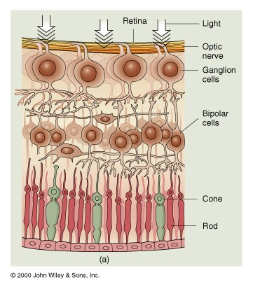
Cone and Rod cells
Notes:
Cones (6 000 000): Provide us with colour vison during the day and give a
sharp image. They need more light to function… during night, no colours.
Rods (125 000 000): Black and white vision during night. No sharp image,
but give us information about the shape and relative brightness of objects.

Slide 11
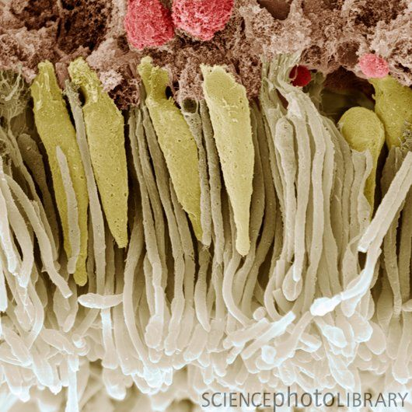
Cones
Rods
Notes:
Electron microscope

Slide 12
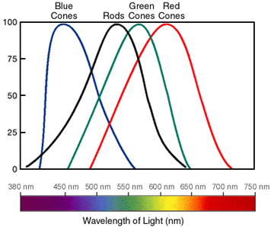
Notes:
Example: 600nm yellow: Which cone cells are signalling to what extent (percentage)?
(blue: 0, green ca. 60, red ca. 100 → yellow) SWF. Colours PPT: Cones
When all cone cells are signalling 100 % we perceive “white”.
All colours we see are a combinations of the activity of three cone cell types!!!
PPT: Pixels in computer
Colour blindness: Comparing the activity of the cone cells at a colour of 560 nm light wave length and cone cells at 650nm
„red“ cone cells signal to 75%, green to 100%: green b) green not active and red 75% signaling
What happens if a person has a defective allele that makes the green cone cells unfunctional... Looking at the same wave lengths?

Slide 13
Notes:
PPT: Pixels in computer

Slide 14
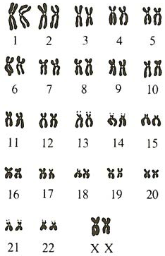
The 46 Human Chromosomes
Male
Female
Notes:
Sex-linked heredity: show if gene on X defect... Male can not compensate with second X.... Females can!!!
In females recessive... only if two copies defective.

Slide 15
Sex-linked Heredity
Notes:
Students

Slide 16
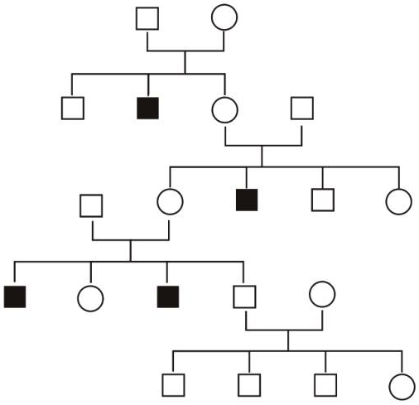
Sex-linked Heredity
XY
XX
XY
XY
XX
XY
XY
XX
XY
XY
XX
or
XX
XX
or
XX
XY
XX
or
XX
XY
XY
XX
or
XX
XY
XY
XY
Notes:
OR: N = Normal n = Hemophilia NN/ Nn/ nn for females NY/ nY for males

Slide 17
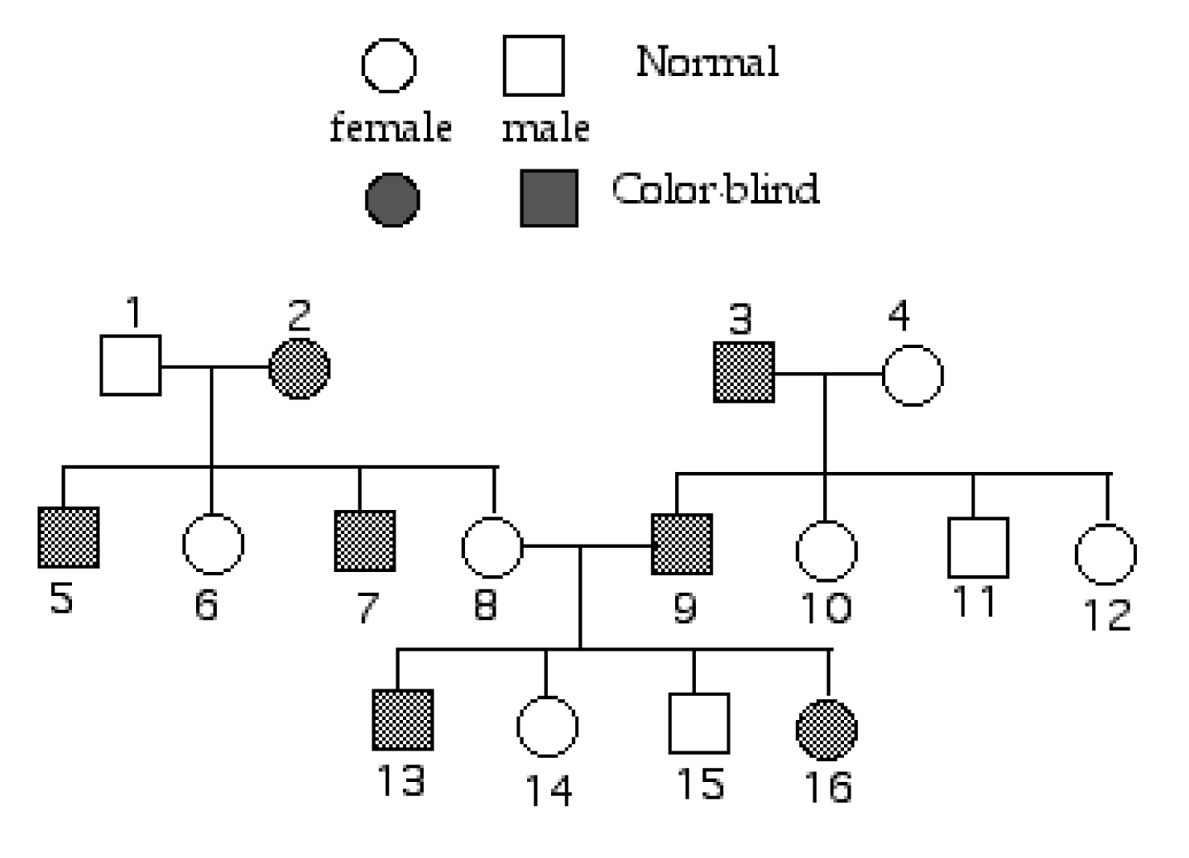
Exercise Colourblindness (X-linked)
Notes:
Examine the following pedigree chart of color-blindness. In humans, color blindness is caused by a recessive sex-linked allele. On the diagram, label the genotypes of the individuals 1-16.

Slide 18
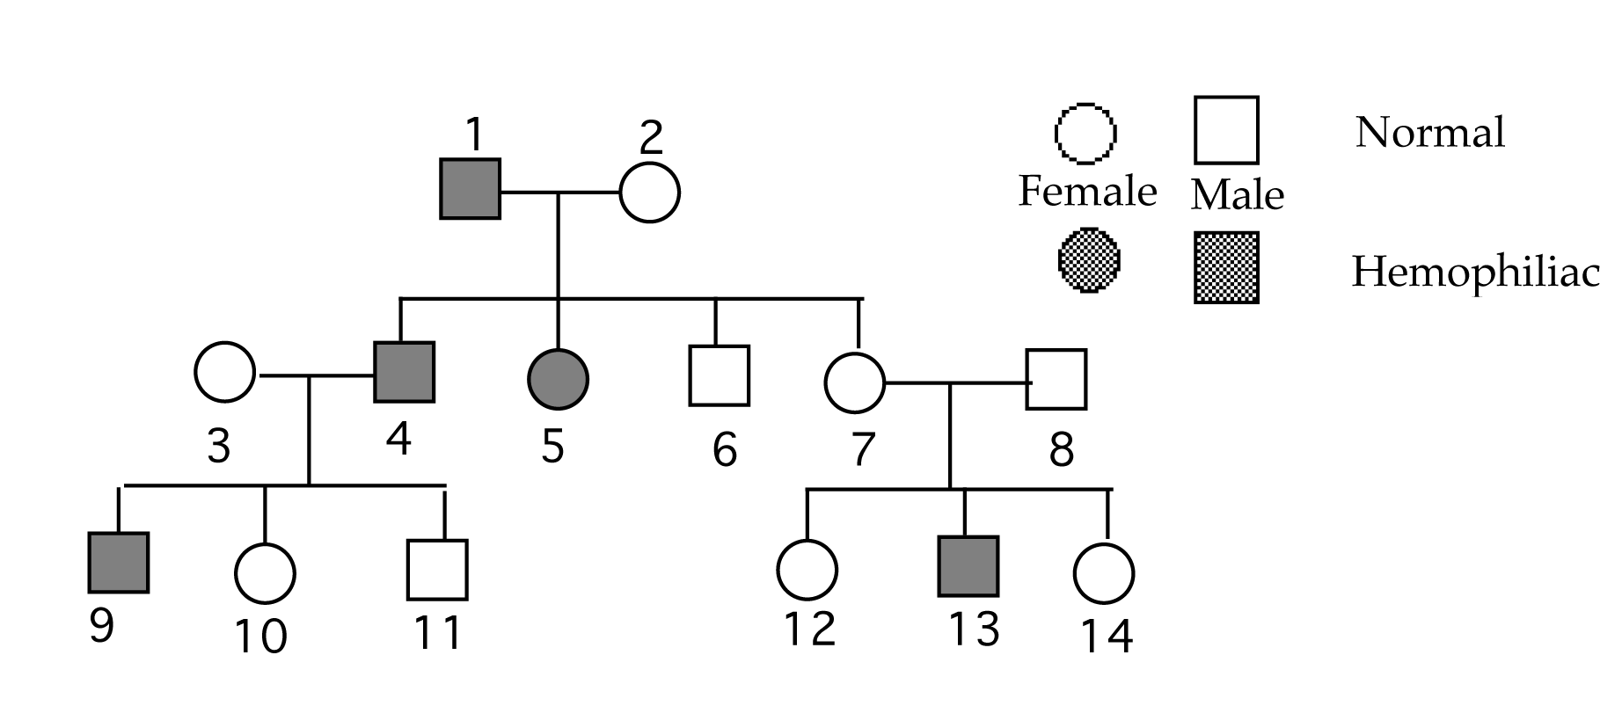
Exercise Hemophilia (X-linked)
Notes:
List the possible genotypes of the following hemophilia pedigree chart below. Remember hemophilia is a sex linked trait that is caused by a recessive allele, therefore you must denote the individuals sex chromosomes (XNXn and XnY or Nn and nY) as well as the hemophilia allele (n).

Slide 19
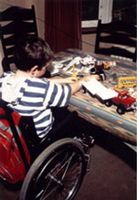
Muscular Dystrophy

Slide 20
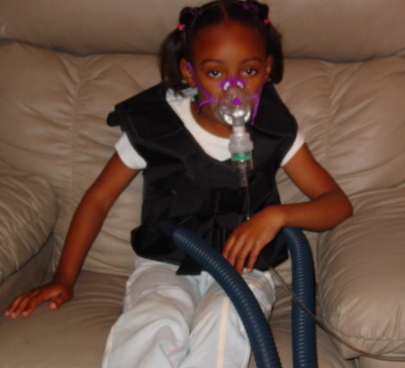
Human Genetic Disorders
Cystic Fibrosis

Slide 21
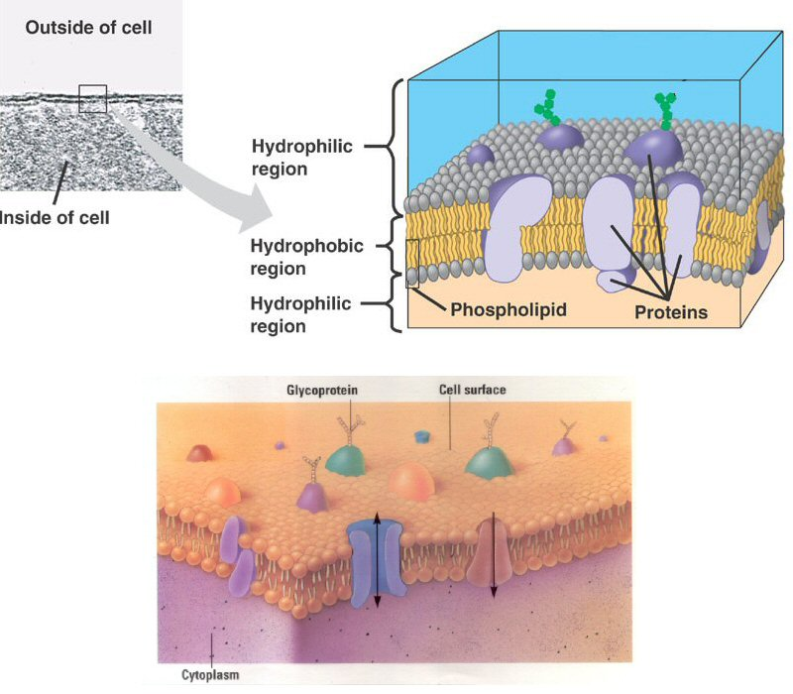
Cell membrane proteins:
→ control of transport into and out of the cell

Slide 22
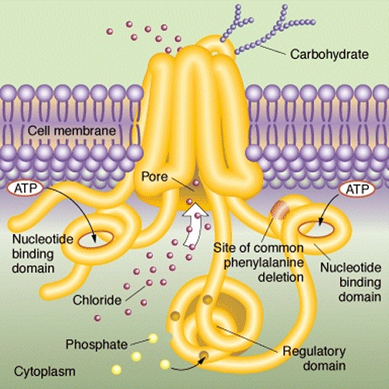
Chlorid channel

Slide 23
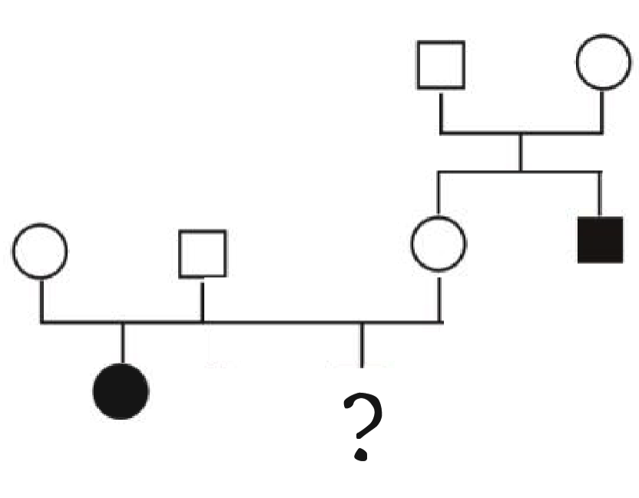
Cc
Cc
Carl
Helen
CC
or
Cc
Cc
Cc
cc
cc

Slide 24
Genotype of Helen ?
Father Mother | C | c
C | CC | Cc
c | Cc | cc

