Slide 1
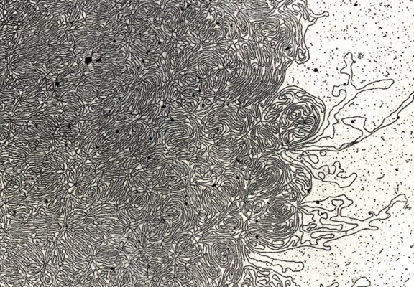
DNA- „Thread“

Slide 2
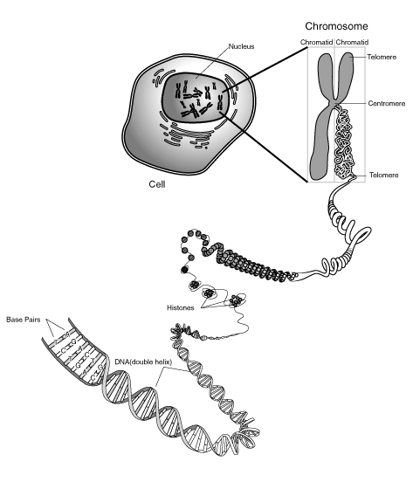
Notes:
Skin, muscle, and nerve cells are some examples of human somatic cells. They display a big variation in form and function, but all of them store their genetic information in the cell nucleus. Structures, called chromosomes, are the carriers of this information. They consist of a long, very thin „thread“ of DNA, in which this information is encoded.

Slide 3
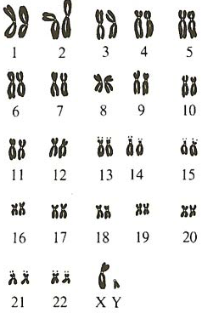
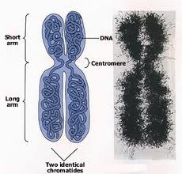

Slide 4
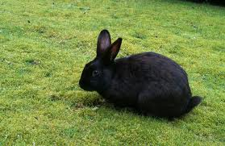
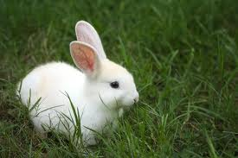
Rabbit Family Tree
? %
Notes:
Explain scheme
...let them try for some time!!!
Procedure:

Slide 5
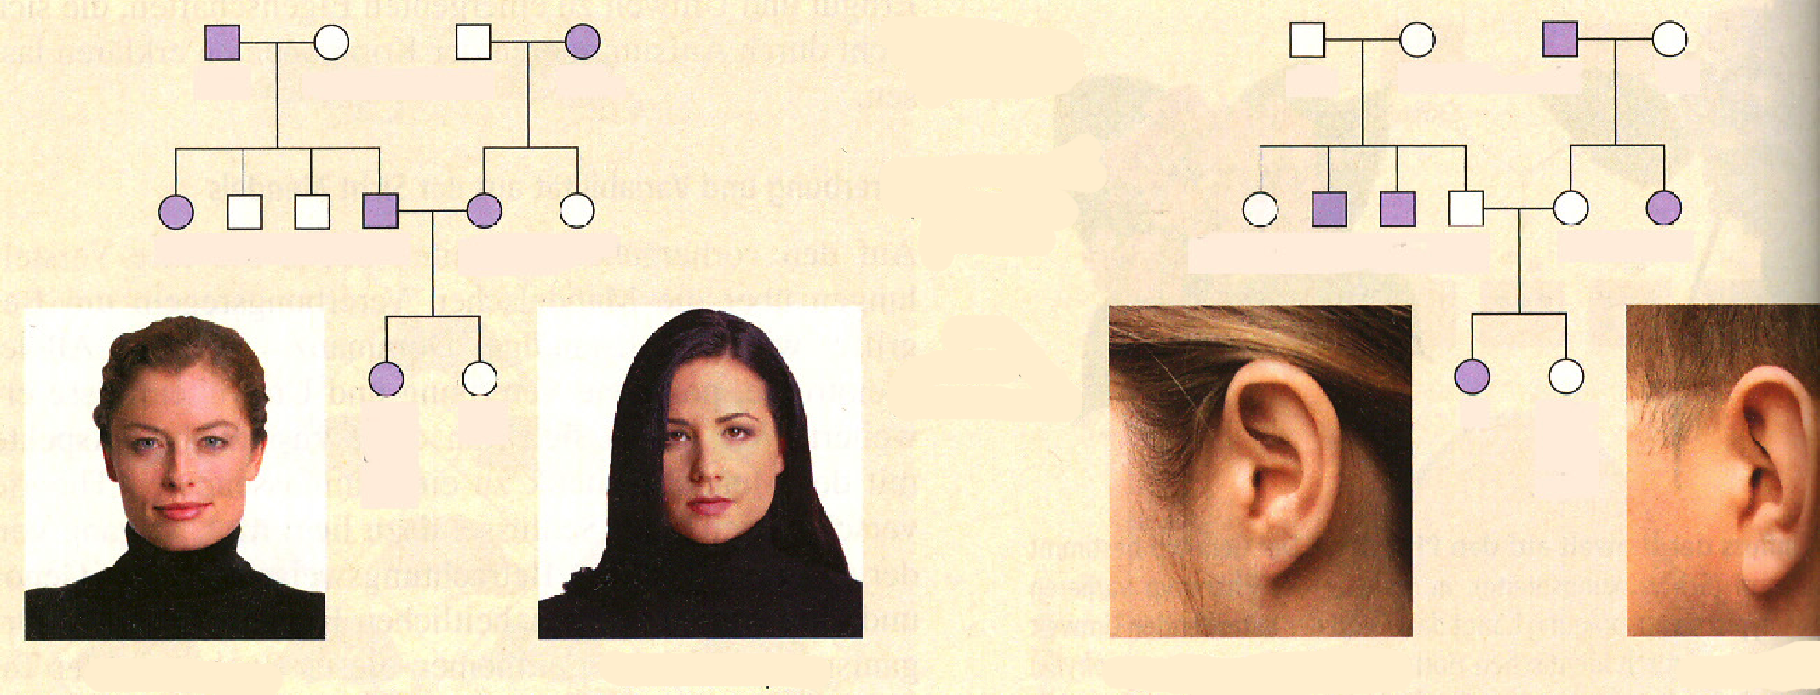
Dominant or Recessive?
1
2
3
4
1
2
3
4
5
6
7
8
9
10
5
6
7
8
9
10
11
12
11
12
Notes:
We are studying how traits are transmitted from one generation to the next. Here, Widow‘s peak or Attached ear lobes. These traits are transmitted by a single gene... Monogenous. Other traits as body height or skin colour are influenced by many genes and too complicated to follow.
But there are also some severe human disorders that are inherited by a single gene and transmitted in the same way as the examples above.
Explain: male/ female... 1. / 2. / 3. Generation

Slide 6
Dominant
Recessive
1
2
3
4
1
2
3
4
Ww
ww
ww
Ww
Ff
Ff
ff
Ff
FF
5
6
7
8
9
10
or
5
6
7
8
9
10
Ww
ww
Ww
Ww
ww
ww
Ff
ff
ff
Ff
Ff
ff
11
12
11
12
WW
ww
ff
FF
or
or
Ff
Ww
W
w
f
F
Notes:
If one parent is homozygous dominant for free earlobes, while the other has attached earlobes can they produce any children with attached earlobes?

Slide 7
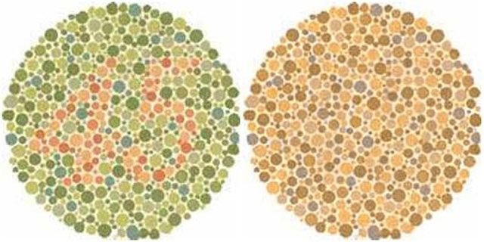
Colour Blindness
„normal vision“
„Colour blind“
Notes:
About 8 percent of males, but only 0.5 percent of females, are color blind… gene for normal functioning on the X-Chromosome!!!!
Not a problem to live with that. Not a disorder!

Slide 8
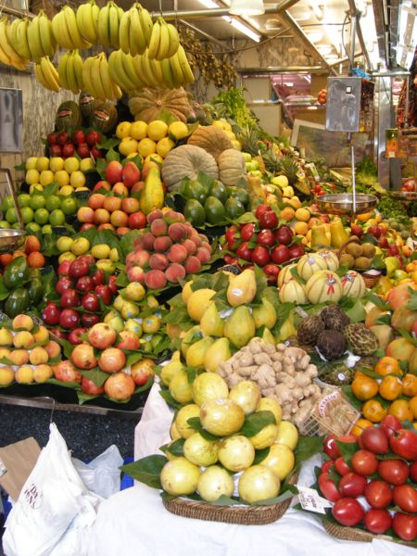
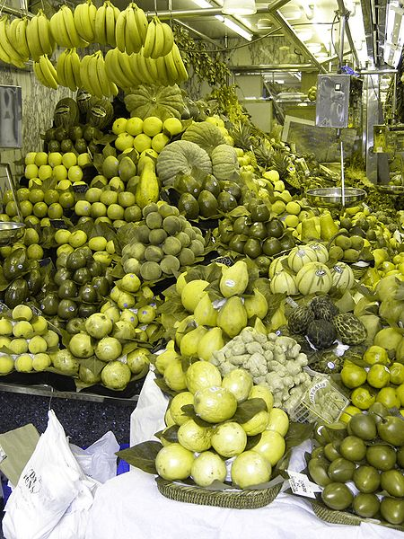
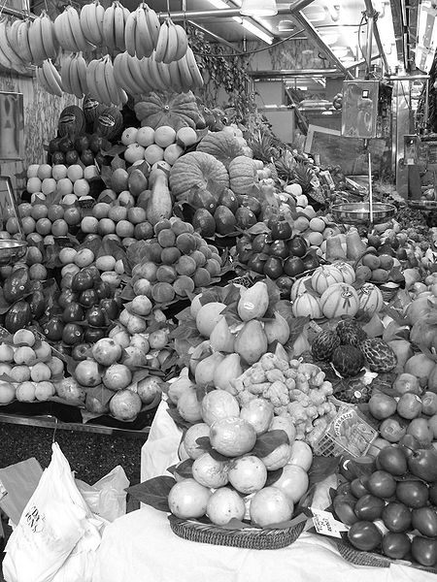
red or green receptors
missing
→„Dischchromatopsia“
no receptors for
colours → „black
and white“ vision
„normal“ vision
3 receptors
2 receptors
no receptor

Slide 9
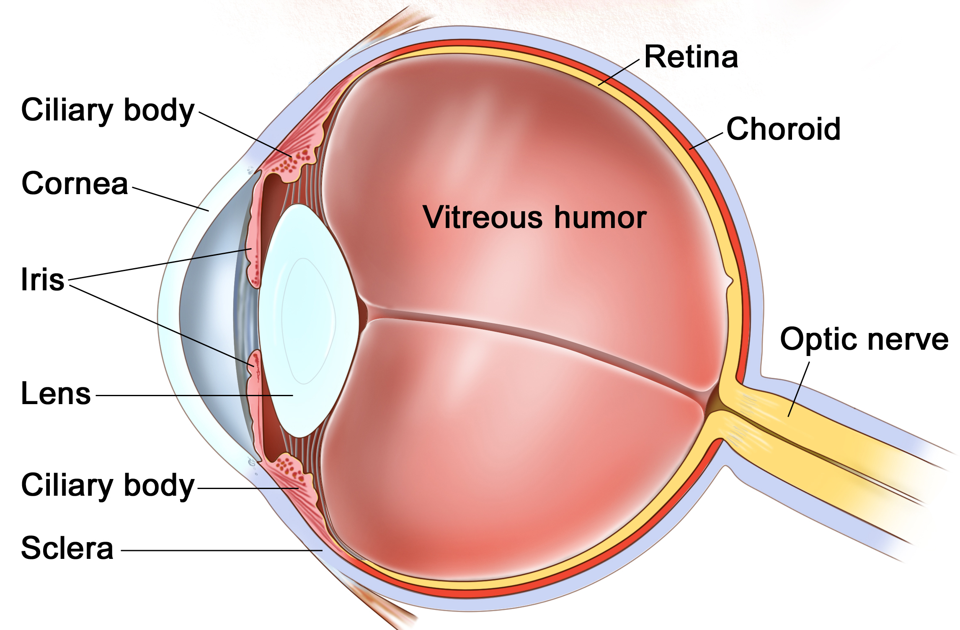
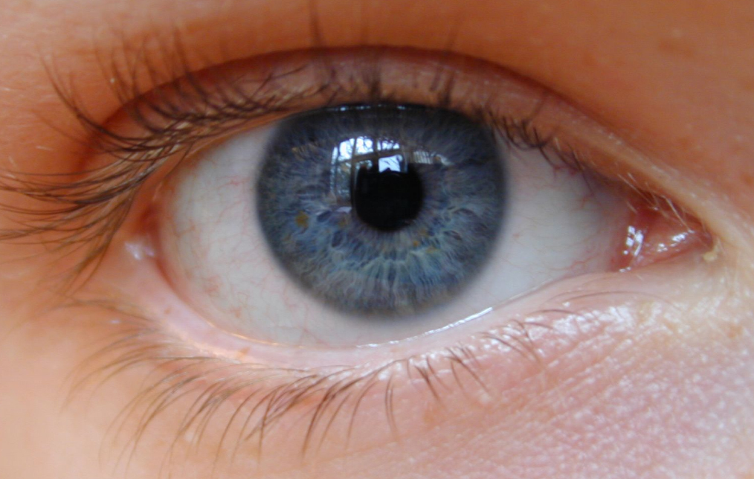
Anatomy of the Eye
Pupil
Blind spot
Notes:
Cornea / Lens Responsible for the Refraction/Bending of the light… adjustable bending is important to get a sharp image (later)
Refraction/ Bending→ show laser
(Change of medium→ change of direction)
show animation “the lens”
Iris / Pupil Eyecolour = Colour of the Iris.
Controls the amount of light entering the eye through the Pupil.
“Experiment”: Teamwork (1+1)
Other Person closes its eyes (ca. 10s.), then open…Other Person flashes with
the light into the eye.
Never flash into eyes with a laser pointer!(damaging the retina)
What happened? → Pupil got smaller.
Much Light entering… Reflex (you cannot deliberately control this): Sensory
cells in the retina messure the amount of light and send signals to muscles adjust the diameter of the pupil… it gets smaller. Less light… bigger
Retina: 2 types of sensory receptors

Slide 10
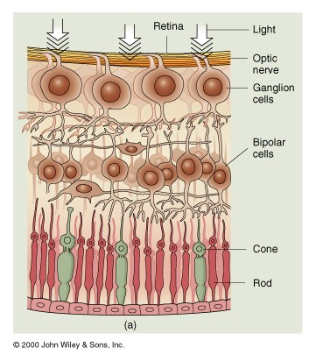
Cone and Rod cells
Notes:
Cones (6 000 000): Provide us with colour vison during the day and give a
sharp image. They need more light to function… during night, no colours.
Rods (125 000 000): Black and white vision during night. No sharp image,
but give us information about the shape and relative brightness of objects.

Slide 11
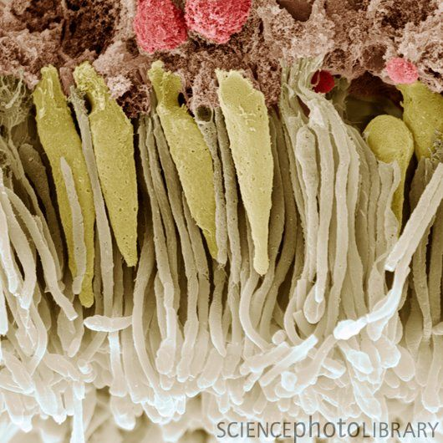
Cones
Rods
Notes:
Electron microscope

Slide 12
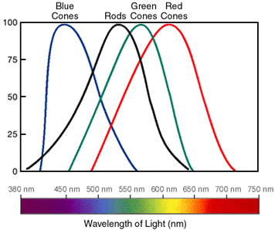
Notes:
Example: 600nm yellow: Which cone cells are signalling to what extent (percentage)?
(blue: 0, green ca. 60, red ca. 100 → yellow) SWF. Colours PPT: Cones
When all cone cells are signalling 100 % we perceive “white”.
All colours we see are a combinations of the activity of three cone cell types!!!
PPT: Pixels in computer
Colour blindness: Comparing the activity of the cone cells at a colour of 560 nm light wave length and cone cells at 650nm
„red“ cone cells signal to 75%, green to 100%: green b) green not active and red 75% signaling
What happens if a person has a defective allele that makes the green cone cells unfunctional... Looking at the same wave lengths?

Slide 13
Notes:
PPT: Pixels in computer

Slide 14
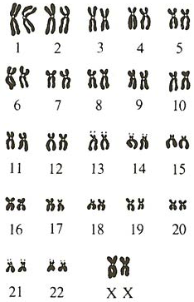
The 46 Human Chromosomes
Male
Female
Notes:
Sex-linked heredity: show if gene on X defect... Male can not compensate with second X.... Females can!!!
In females recessive... only if two copies defective.

Slide 15
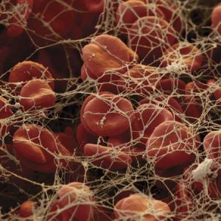
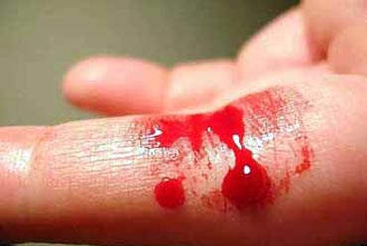
Haemophilia (X-linked)
Blood Clotting
Blood Clotting not functioning
➔Excessive bleeding

Slide 16
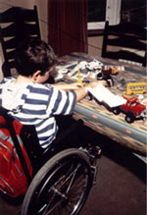
Muscular Dystrophy (X-linked)

Slide 17
Sex-linked Heredity
Notes:
Students

Slide 18
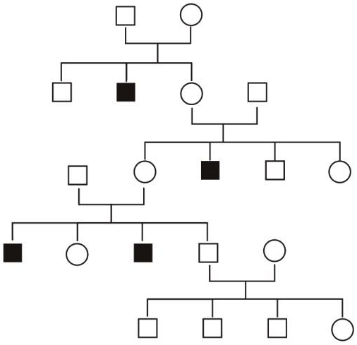
Sex-linked Heredity
XY
XX
XY
XY
XX
XY
XY
XX
XY
XY
XX
or
XX
XX
or
XX
XY
XX
or
XX
XY
XY
XX
or
XX
XY
XY
XY
Notes:
OR: N = Normal n = Hemophilia NN/ Nn/ nn for females NY/ nY for males

Slide 19
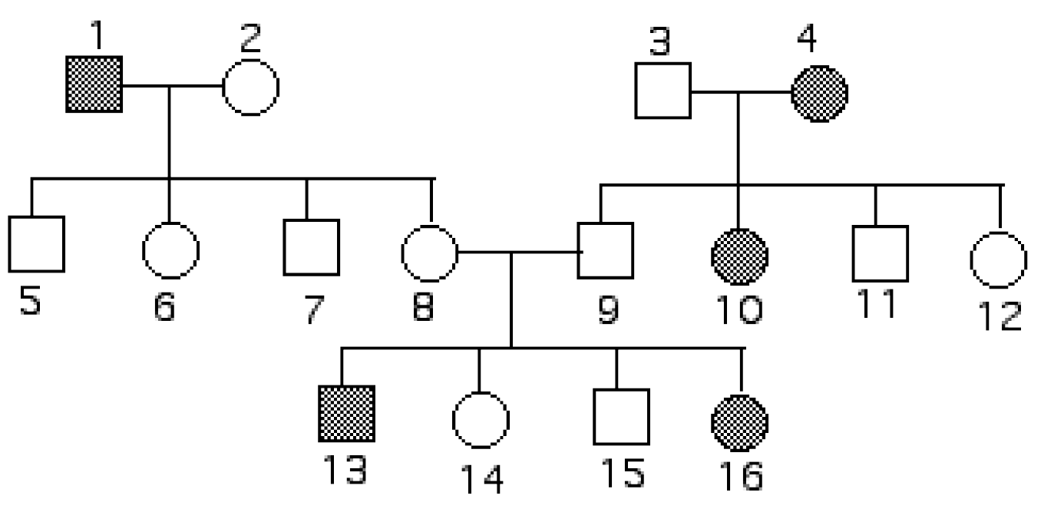
Exercise
1. On X-chromosome (sex-linked) or on Autosome?
2. Dominant or Recessive
Notes:
Determine if the following disorder is…
a) …inherited by a gene located on the X-chromosome (Sex-linked) or on an autosome? _____________
b) …dominantly or recessively inherited? _______________
Place all the possible genotypes of every individual of the family tree. Use the letters “D” and “d”.

Slide 20
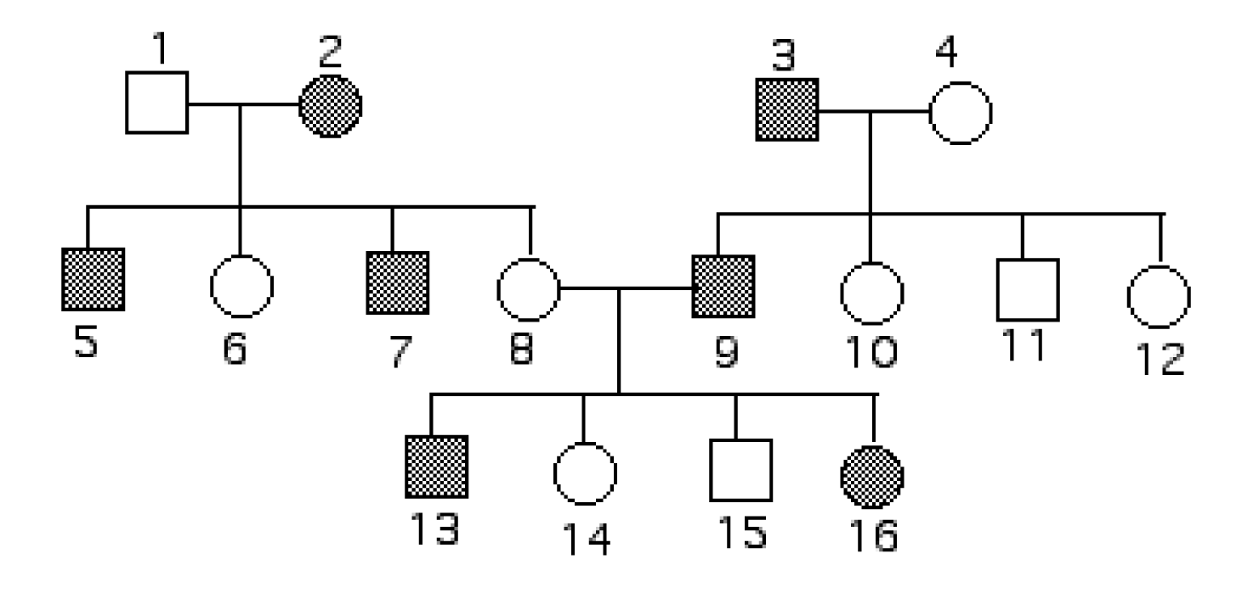
Exercise Haemophilia (X-linked)
Notes:
Place all the possible genotypes of every individual of the family tree. Use red colour for the affected X.
Or XNXn / YXN YXn

Slide 21
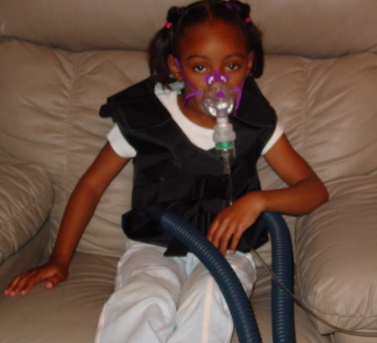
Human Genetic Disorders
Cystic Fibrosis

Slide 22
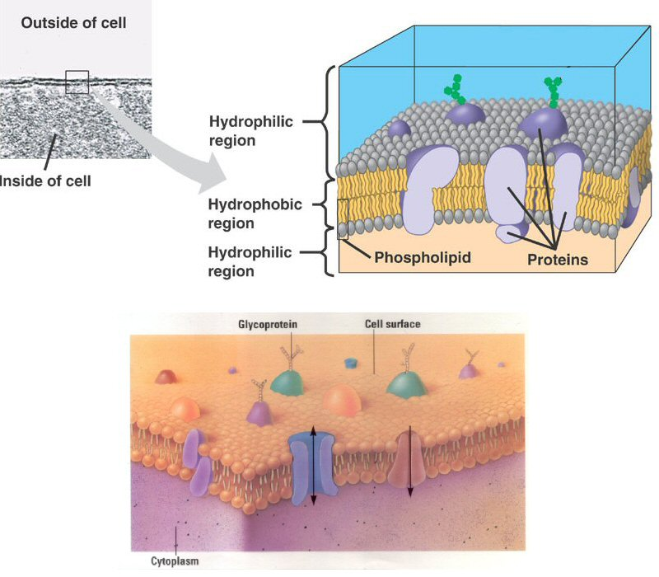
Cell membrane proteins:
→ control of transport into and out of the cell

Slide 23
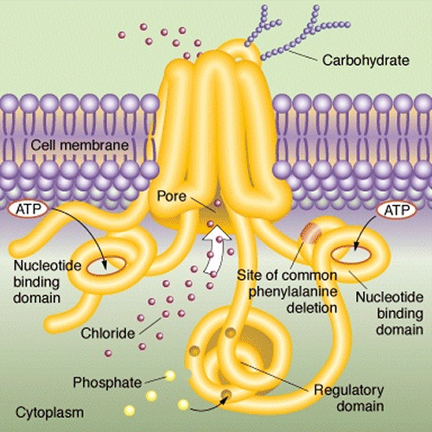
Chlorid channel

Slide 24
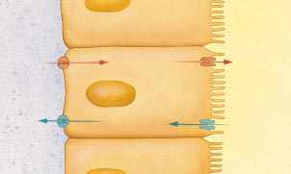
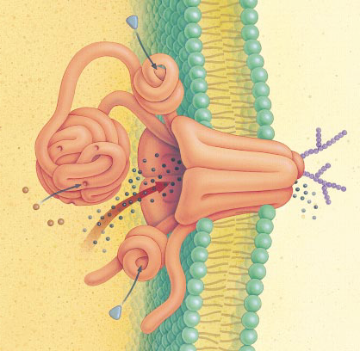
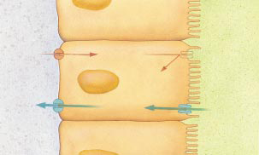
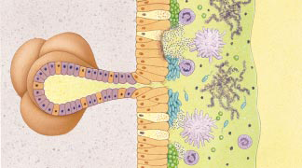
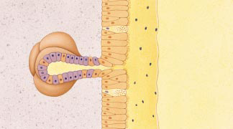
Effect on Lungs
Chloride channel
transports salt through protein channel out of cell
Osmosis: H₂O follows Cl–
normal lungs
airway
Cl–
Cl– channel
H₂O
cells lining lungs
cystic fibrosis
Cl–
H₂O
bacteria & mucus build up
thickened mucus
hard to secrete
mucus secreting glands

Slide 25
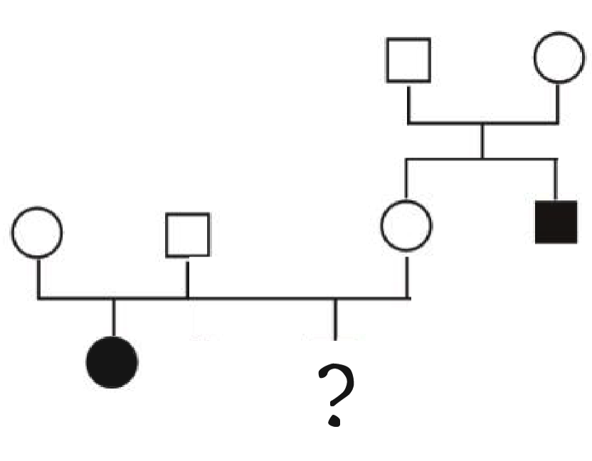
Cc
Cc
Carl
Helen
CC
or
Cc
Cc
Cc
cc
cc

Slide 26
Genotype of Helen ?
Father Mother | C | c
C | CC | Cc
c | Cc | cc

Slide 27
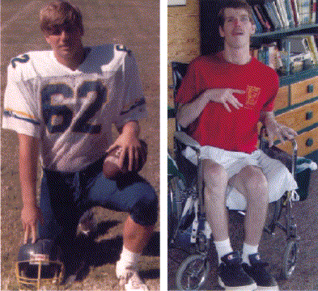
Chorea Hutington patient
18 years
33 years

