Slide 1
yellow seeds (Y)
green seeds (y)
27
29
Notes:
In pea plants, yellow seeds (Y) are dominant and green seeds (y) are recessive. A pea plant with yellow seeds is crossed with a pea plant with green seeds. The resulting offspring have about equal numbers of yellow and green seeded plants.
What are the genotypes of the parents? …. and the children.

Slide 2
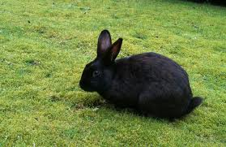
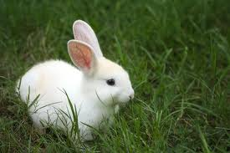
12
4
Notes:
Colour of fur: How inerited? Dominant / recessive / or incomplete dominance?
What is dominant? black
Genotypes of all the Rabbits?
What about the genotypes of the black rabbits?

Slide 3
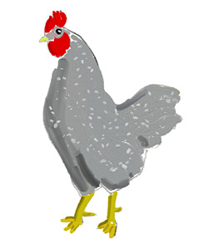


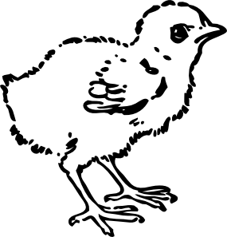
grey
grey
9
16
7
white
grey
black
Notes:
Explain this result:
Inheritance!
Genotypes!

Slide 4
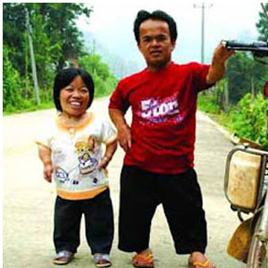
Achondroplasia (Dwarfinism)
- Dominant (D)
- Homozygous (DD) children die
shortly after birth
How big is the chance for this couple to have a child
that will be of normal height?
Notes:
Achondroplasia ( /əˌkɒndrɵˈpleɪziə/) is a common cause of dwarfism. It occurs as a sporadic mutation in approximately 75% of cases (associated with advanced paternal age) or may be inherited as an autosomal dominant genetic disorder.
Achondroplastic dwarfs have short stature, with an average adult height of 131 centimeters (51.5 inches) for males and 123 centimeters (48.4 inches) for females. The disorder itself is caused by a change in the DNA for fibroblast growth factor receptor 3 (FGFR3), which causes an abnormality of cartilage formation. If both parents of a child have achondroplasia, and both parents pass on the mutant gene, then it is very unlikely that the homozygous child will live past a few months of its life. The prevalence is approximately 1 in 25,000.[1]

Slide 5
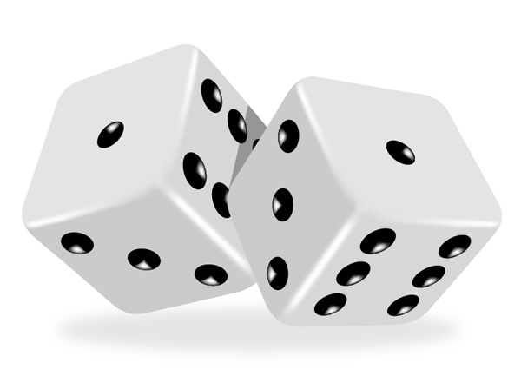
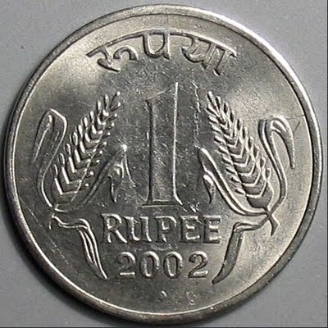
Mathematics: Probability
Notes:
Probability (P) of one event:

Slide 6
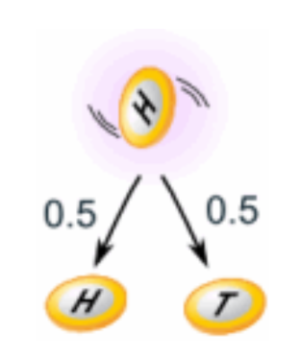
^{Example:}
What is the probability of getting a ^{"Head" when tossing a coin?}
Number of ways it can happen: 1 (Head)
Total number of outcomes: 2 (Head and Tail)
^{Probability (P) = 1/2 = 0.5}

Slide 7
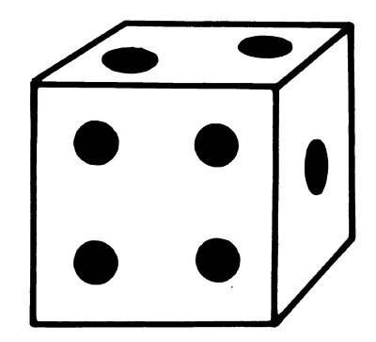
Example:
What is the probability of getting a "5" or "6" when rolling a dice?
Number of ways it can happen: 2 ("5" and "6")
Total number of outcomes: 6 ("1", "2", "3", "4", "5" and "6")
Probability (P) = 2/6 = 1/3 = 0.33

Slide 8
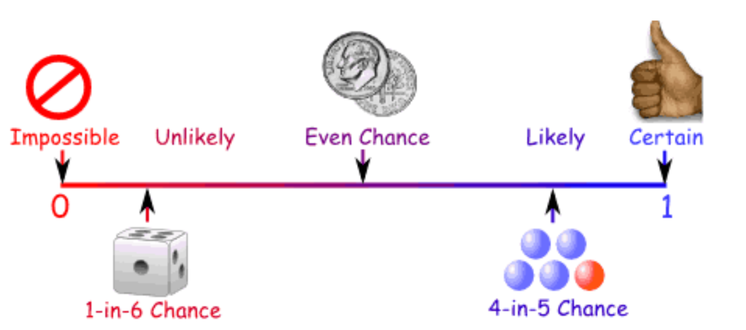
Ways of showing Probability

Slide 9
^{Example:}
Probability of getting a ”Number up" when tossing a coin:
^{As a decimal: 0.5}
^{As a fraction: 1/2}
^{As a percentage: 50%}

Slide 10
Probability
Two independent Events:
Two events , A and B, are independent if the fact that A occurs does
not affect the probability of B occurring
Example:
Landing „Number up“ after tossing a coin AND rolling a „5“ on a single 6- sided dice.
b) Picking blindly a red „chromosome“ from a bunch of coloured ones AND landing
„Number up“ after tossing a coin.

Slide 11
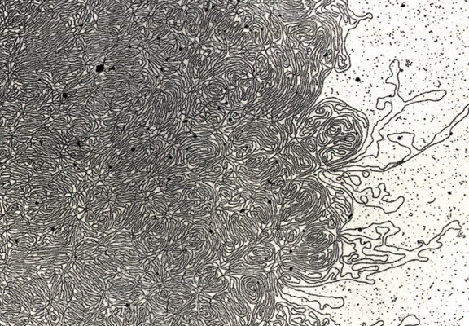
DNA- „Thread“

Slide 12
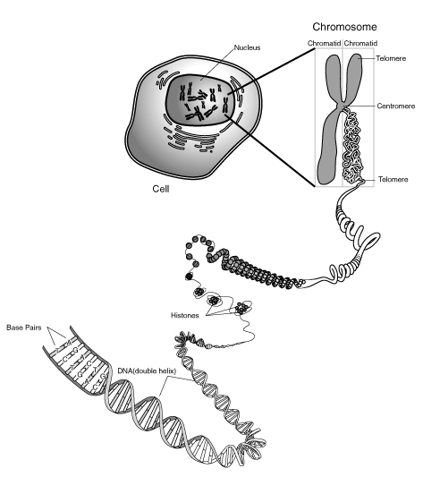
Notes:
Skin, muscle, and nerve cells are some examples of human somatic cells. They display a big variation in form and function, but all of them store their genetic information in the cell nucleus. Structures, called chromosomes, are the carriers of this information. They consist of a long, very thin „thread“ of DNA, in which this information is encoded.

Slide 13
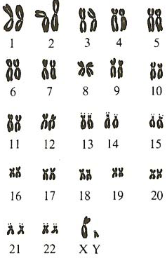
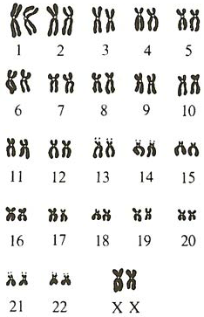
The 46 Human Chromosomes
Male
Female
Notes:
Sex-linked heredity: show if gene on X defect... Male can not compensate with second X.... Females can!!!
In females recessive... only if two copies defective.

Slide 14
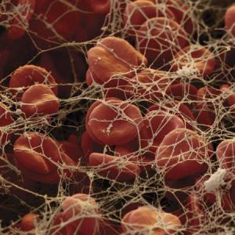
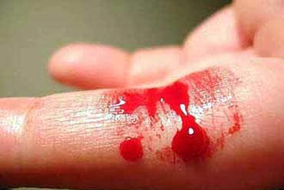
Haemophilia (X-linked)
Blood Clotting
Blood Clotting not functioning
➔Excessive bleeding

Slide 15
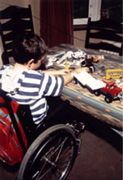
Muscular Dystrophy (X-linked)

Slide 16
Sex-linked Heredity
Notes:
Students

Slide 17
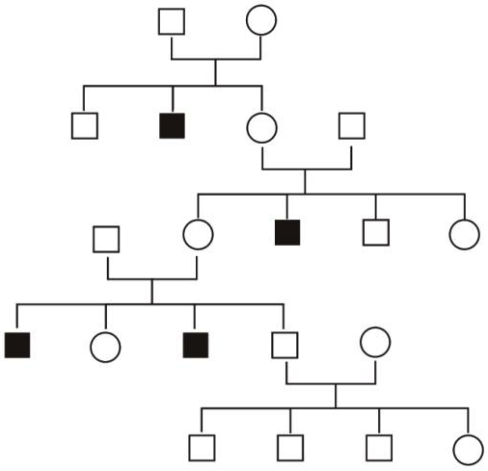
Sex-linked Heredity
XY
XX
XY
XY
XX
XY
XY
XX
XY
XY
XX
or
XX
XX
or
(XX)
XY
XX
or
XX
XY
XY
XX
or
(XX)
XY
XY
XY
Notes:
OR: N = Normal n = Hemophilia NN/ Nn/ nn for females NY/ nY for males

Slide 18
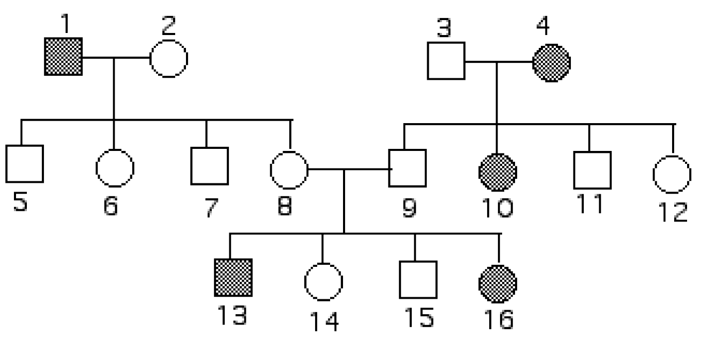
Exercise
1. On X-chromosome (sex-linked) or on Autosome?
2. Dominant or Recessive
Notes:
Determine if the following disorder is…
…inherited by a gene located on the X-chromosome (Sex-linked) or on an autosome? Autosom
b) …dominantly or recessively inherited? _______________
Place all the possible genotypes of every individual of the family tree. Use the letters “D” and “d”.

Slide 19
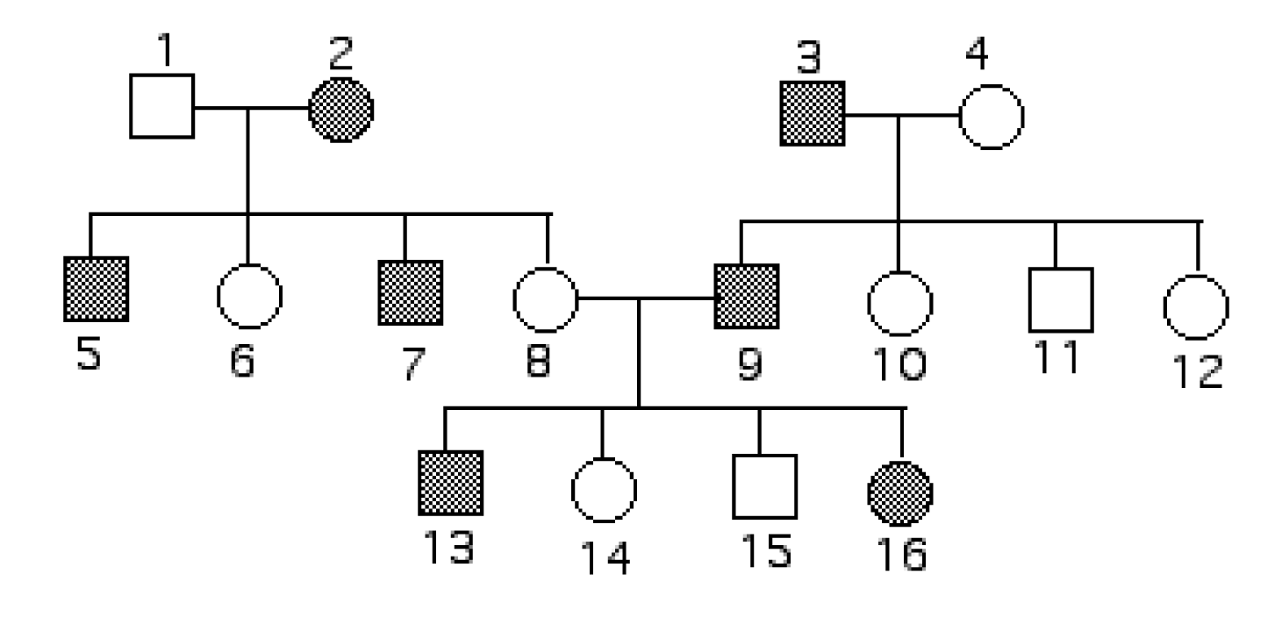
Exercise Haemophilia (X-linked)
Notes:
Place all the possible genotypes of every individual of the family tree. Use red colour for the affected X.
Or XNXn / YXN Yxn
Exercise Family Tree:
Tashi sagt, dass er eines seiner beiden Geschlechtschromosomen mit Sicherheit von einem seiner Grossväter und das andere von einer seiner Grossmütter geerbt hat. Korrekt? Begründen Sie mit Hilfe eines Stammbaums. ...nein (vom Grossvater oder Grossmutter mütterlicherseits)

Slide 20
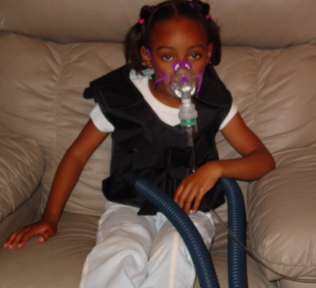
Human Genetic Disorders
Cystic Fibrosis

Slide 21
Exercise
Imagine you would be a counsellor giving advice to a couple which is thinking of having a baby.
Carl was already married to another woman and they had a baby with cystic fibrosis.
The Brother of his present woman Helen died of cystic fibrosis.
ཁྱོད་རང་སློབ་སྟོན་པ་གཞི་ཡིན་པའི་ཚོད་དཔག་བྱེད་ནས་བཟའ་ཚང་ཕྲུ་གུ་དགོས་འདོད་པ་གཞི་ལ་བསླབ་བྱ་སྤྲོད།
ཀྲརལ་ནི་སྐྱེས་མ་གཞན་གཞི་མཉན་དུ་གཉེན་སྒྲིག་ཟིན་པ་དང་ཁོ་ཚོ་ལ་ཕྤུ་གུ་ གྲོད་ཁུག་གི་རྩ་རྒྱུས་སྐྲངས་ནད་པ་གཞི་ཡོད།
ད་ལྟ་ཁོ་རང་གི་སྐྱེས་མ་ཧ་ལེན་གྱི་གཅེན་པོ་གྲོད་ཁུག་གི་རྩ་རྒྱུས་སྐྲངས་ནད་ནས་འདས་གྲོངས་བྱིན།

Slide 22
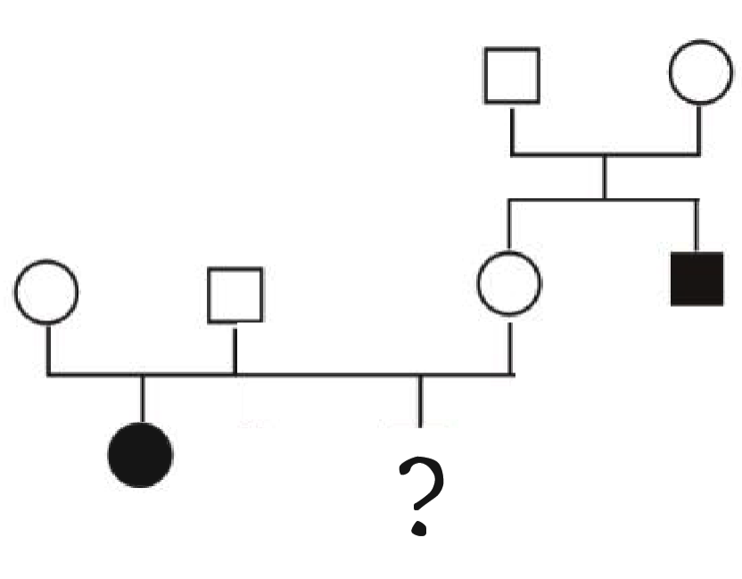
How big is the chance for them to have a baby with cystic fibrosis? _______________
ཁོ་རང་གཉིས་ལ་གྲོད་ཁུག་གི་རྩ་རྒྱུས་སྐྲངས་ནད་ཡོད་པའི་ཕྲུ་གུ་ཉེན་ཁ་ཇི་ལྟར་ཆེན་པོ་ཡོད་དམ། _______________
c = cystic fibrosis allele
C = normal allele
Cc
Cc
Carl
Helen
CC
or
Cc
Cc
Cc
cc
cc

Slide 23
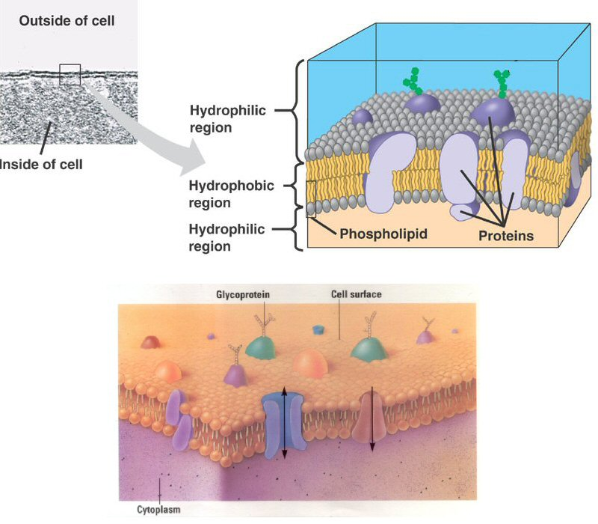
Cell membrane proteins:
→ control of transport into and out of the cell

Slide 24
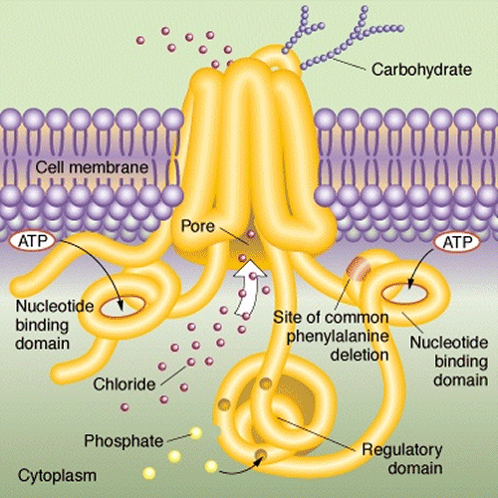
Chlorid channel

Slide 25
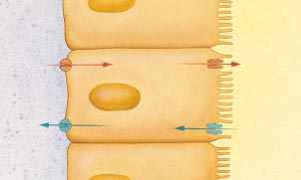
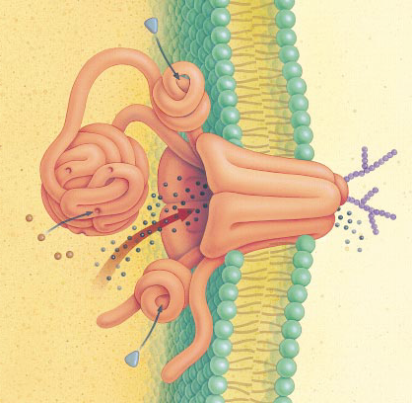
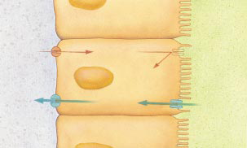
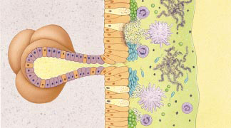
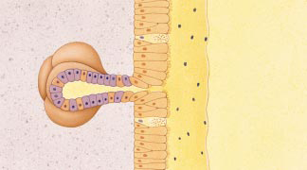
Effect on Lungs
Chloride channel
transports salt through protein channel out of cell
Osmosis: H₂O follows Cl–
normal lungs
airway
Cl–
Cl– channel
H₂O
cells lining lungs
cystic fibrosis
Cl–
H₂O
bacteria & mucus build up
thickened mucus
hard to secrete
mucus secreting glands

Slide 26
Genotype of Helen ?
Father Mother | C | c
C | CC | Cc
c | Cc | cc

Slide 27
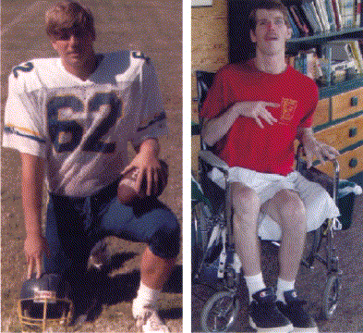
Chorea Hutington patient
18 years
33 years

