Slide 1
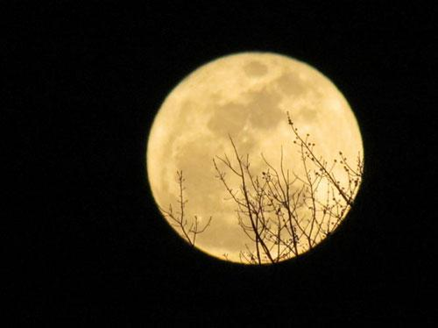
„Supermoon“
Night of the 5th to 6th May 2012
Notes:
During today’s night the Full Moon will appear especially big and bright compared to other Full Moons.

Slide 2
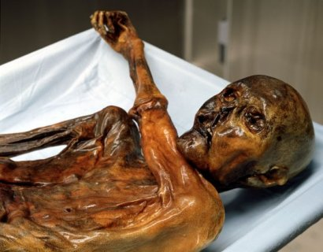
Ötzi
Age determined by „C14- Method“

Slide 3
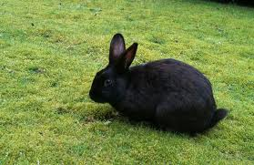
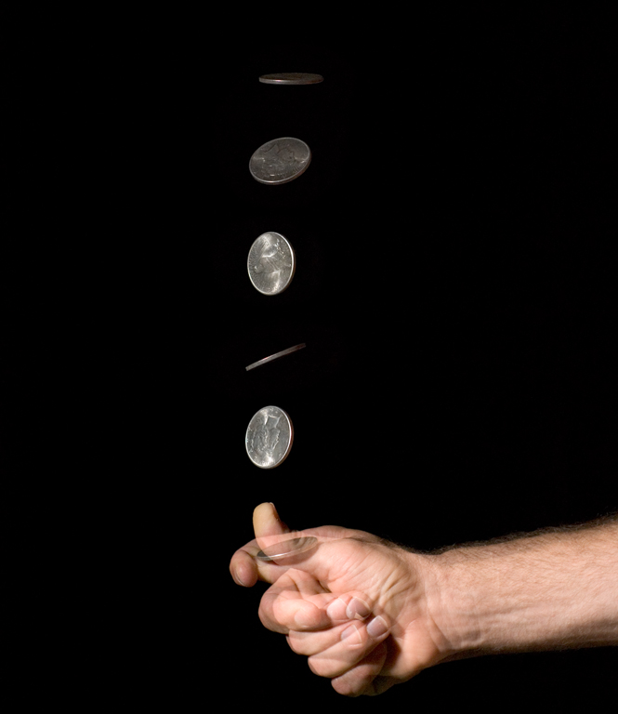
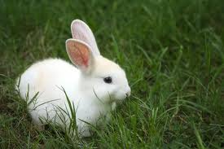
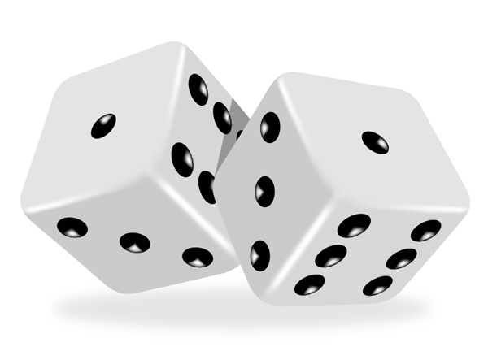
Mathematics: Probability (P)
Notes:
Doing Genetics and looking at family trees we came across the topic of probability. Mathematics is needed to do Biology!
Probability means how likely an event is going to happen.
For example:

Slide 4
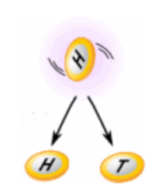
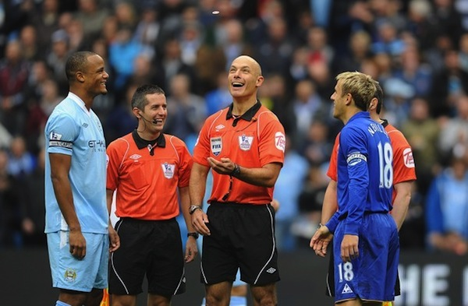
^{Example:}
What is the probability of getting a ^{"Head" when tossing a coin?}
0.5
0.5
RULE
Number of ways it can happen: 1 (Head)
Total number of outcomes: 2 (Head or Tail)
^{Probability (P) = 1/2 =} ^{0.5}

Slide 5
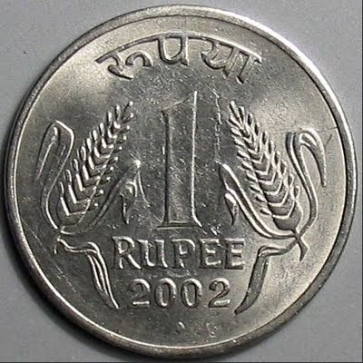
Probability Test:
1.Tossing a coin.
2.Picking blindly between a red and and a differently coloured chromosome.
What is the probability for „Number up“ (A) AND picking the red chromosome (B)?
P(A) = 1/2 P(B) = 1/2
P (A+B) = 1/2 x 1/2 = 1/4 = 25%

Slide 6
Repetition Pages Nr. 6 -14
A) Heredity and Chromosomes
1. Where is the genetic information stored in an organism? __________________
2. In which structures is it organised? ______________________
B) Human Chromosomes
How many chromosomes are there in human cells? ________
...in each cell? ____________________________
2. Which parent‘s gamete determines the sex of a child? ______________

Slide 7
3. a) A cell contains 44 autosomes and a two X-chromosomes.
What kind of cell is it? ____________________________
b) A cell contains 22 autosomes and one X-chromosomes.
What kind of cell is it? ____________________________
4. Right or wrong?
a) Homologous chromosomes carry the same alleles. ______________
b) A skin- and a muscle cell of the same organism carry the
identical genetic information. ___________________

Slide 8
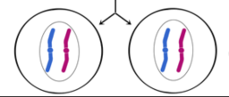
C) Mitosis and Meiosis
Name two differences between Mitosis and Meiosis
_________________
_________________
2. The figure shows the outcome of...
a) Mitosis or b) Meiosis ?
3. Why is Meiosis necessary? _____________________________
4. Why is Mitosis necessary? _____________________________

Slide 9
5. Right or wrong?
a) Somatic cells carry two alleles of each gene. ____________________
6. Where does Meiosis take place? ________________________
7. Where does Mitosis take place? ________________________

Slide 10
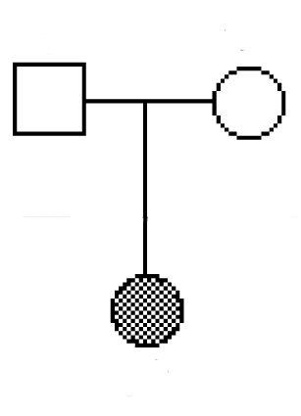
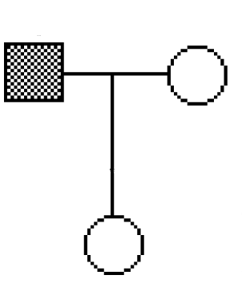
D) Family Trees
1. Is the following phenotype transmitted by a dominant or recessive allele?
a)
b)
2. What is the probability for the outcome as in 1.a)?

Slide 11
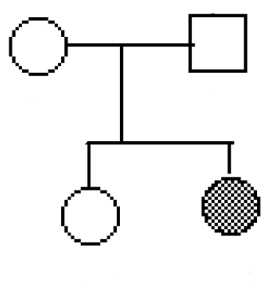
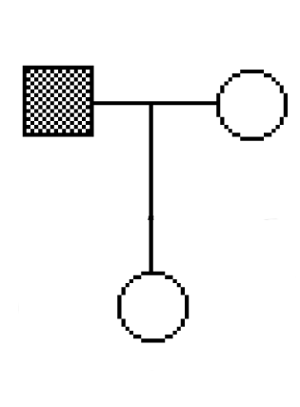
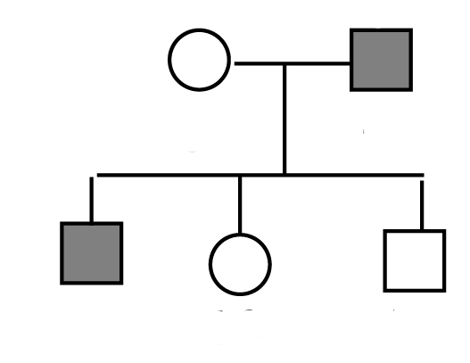
3. Could this be a part of a family tree describing a sex-linked transmitted trait.
a)
b)
4. Why do males more often suffer of disorders like Haemophilia
and Muscular Dystrophy. Explain as precise as possible.
5. Fill in the Genotypes of the family tree that shows a
sex- linked transmitted disorder.
Affected X in red.

Slide 12
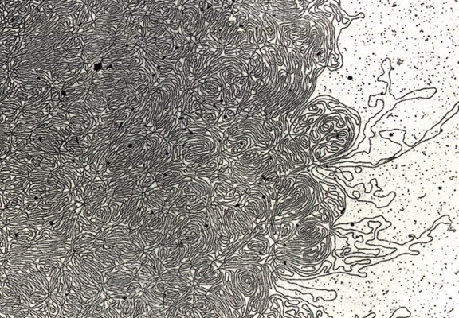
DNA- „Thread“

Slide 13
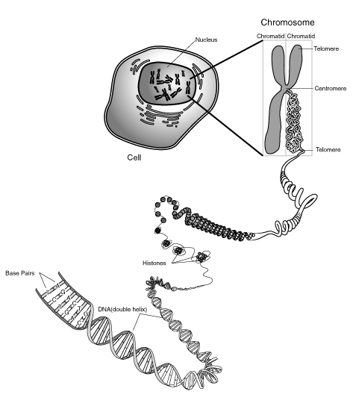
Notes:
Skin, muscle, and nerve cells are some examples of human somatic cells. They display a big variation in form and function, but all of them store their genetic information in the cell nucleus. Structures, called chromosomes, are the carriers of this information. They consist of a long, very thin „thread“ of DNA, in which this information is encoded.

Slide 14
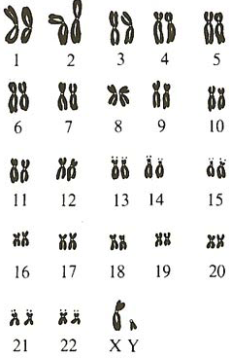
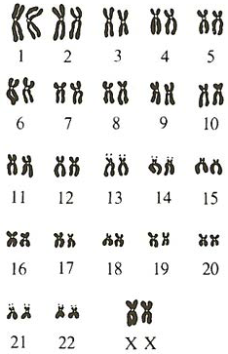
The 46 Human Chromosomes
Male
Female
Notes:
Sex-linked heredity: show if gene on X defect... Male can not compensate with second X.... Females can!!!
In females recessive... only if two copies defective.

Slide 15
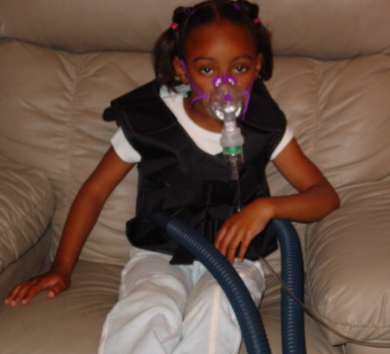
Human Genetic Disorders
Cystic Fibrosis:
- Monogenous
Autosomal
Recessive

Slide 16
Exercise
Imagine you would be a counsellor giving advice to a couple which is thinking of having a baby.
Carl was already married to another woman and they had a baby with cystic fibrosis.
The Brother of his present woman Helen died of cystic fibrosis.
ཁྱོད་རང་སློབ་སྟོན་པ་གཞི་ཡིན་པའི་ཚོད་དཔག་བྱེད་ནས་བཟའ་ཚང་ཕྲུ་གུ་དགོས་འདོད་པ་གཞི་ལ་བསླབ་བྱ་སྤྲོད།
ཀྲརལ་ནི་སྐྱེས་མ་གཞན་གཞི་མཉན་དུ་གཉེན་སྒྲིག་ཟིན་པ་དང་ཁོ་ཚོ་ལ་ཕྤུ་གུ་ གྲོད་ཁུག་གི་རྩ་རྒྱུས་སྐྲངས་ནད་པ་གཞི་ཡོད།
ད་ལྟ་ཁོ་རང་གི་སྐྱེས་མ་ཧ་ལེན་གྱི་གཅེན་པོ་གྲོད་ཁུག་གི་རྩ་རྒྱུས་སྐྲངས་ནད་ནས་འདས་གྲོངས་བྱིན།

Slide 17
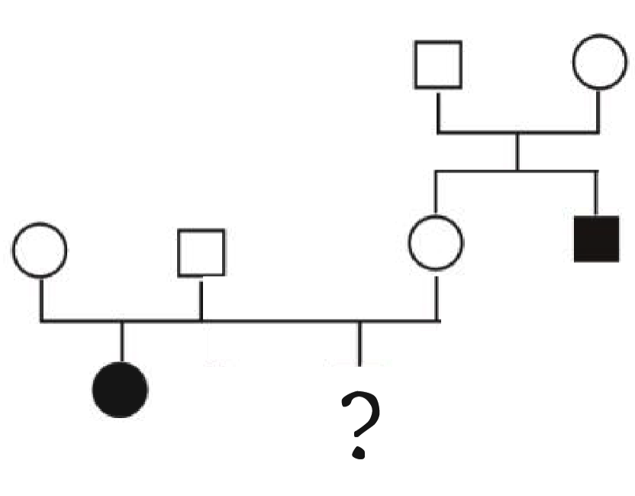
How big is the chance for them to have a baby with cystic fibrosis? _______________
ཁོ་རང་གཉིས་ལ་གྲོད་ཁུག་གི་རྩ་རྒྱུས་སྐྲངས་ནད་ཡོད་པའི་ཕྲུ་གུ་ཉེན་ཁ་ཇི་ལྟར་ཆེན་པོ་ཡོད་དམ། _______________
c = cystic fibrosis allele
C = normal allele
Cc
Cc
Carl
Helen
CC
or
Cc
Cc
Cc
cc
cc

Slide 18
P (Cc): 2/3
Genotype of Helen ?
Father Mother | C | c
C | CC | Cc
c | Cc | cc

Slide 19
P (cc): 1/4
Child with Cystic Fibrosis
Carl Helen | C | c
C | CC | Cc
c | Cc | cc

Slide 20
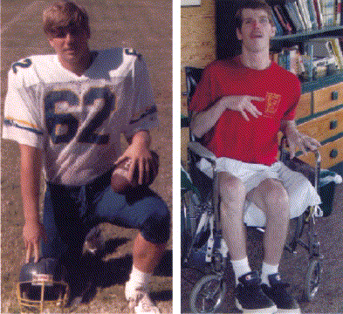
Chorea Hutington Patient
- monogenous
- autosomal
- dominant
18 years
33 years

Slide 21
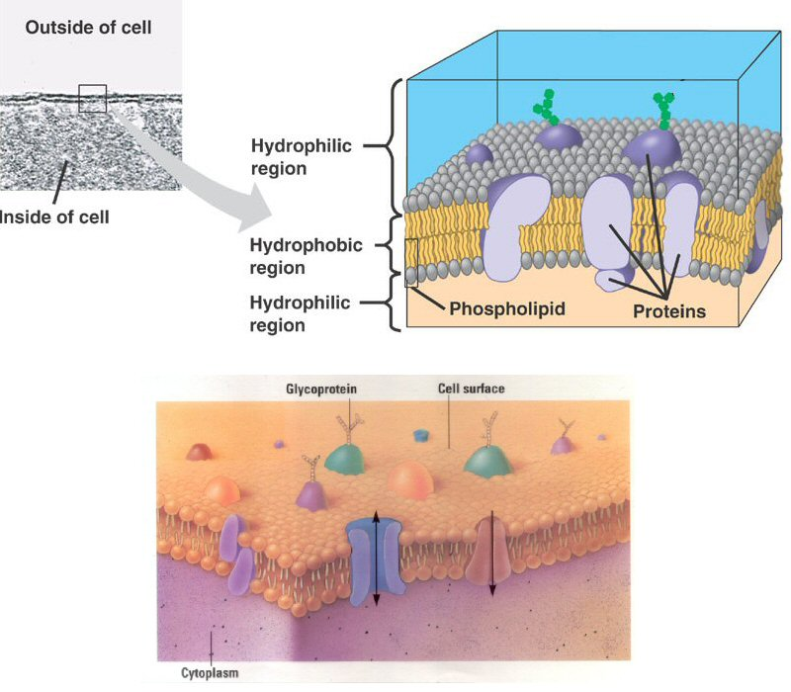
Cell membrane proteins:
→ control of transport into and out of the cell

Slide 22
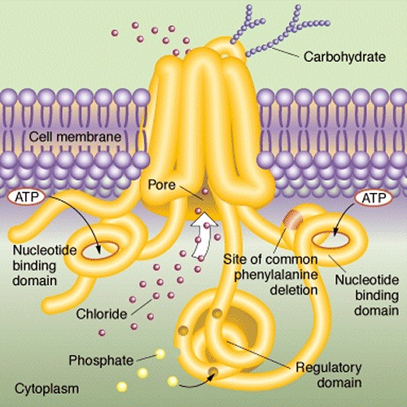
Chlorid channel

Slide 23
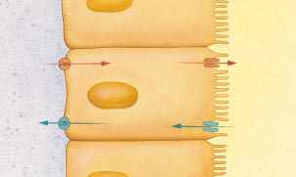
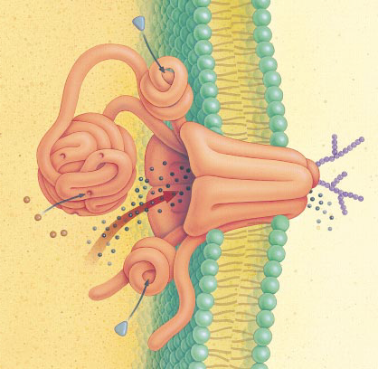
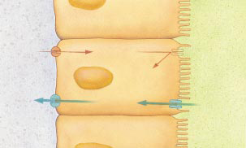
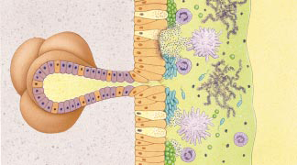
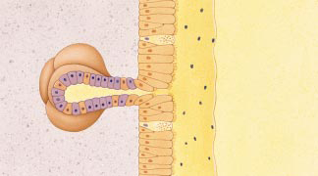
Effect on Lungs
Chloride channel
transports salt through protein channel out of cell
Osmosis: H₂O follows Cl–
normal lungs
airway
Cl–
Cl– channel
H₂O
cells lining lungs
cystic fibrosis
Cl–
H₂O
bacteria & mucus build up
thickened mucus
hard to secrete
mucus secreting glands

