Slide 1
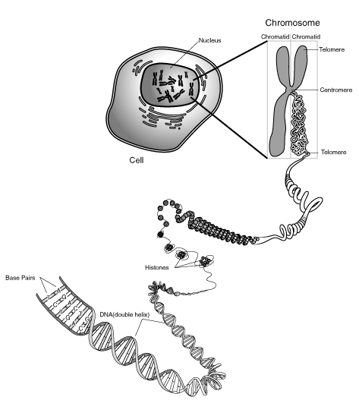
Notes:
DNA

Slide 2
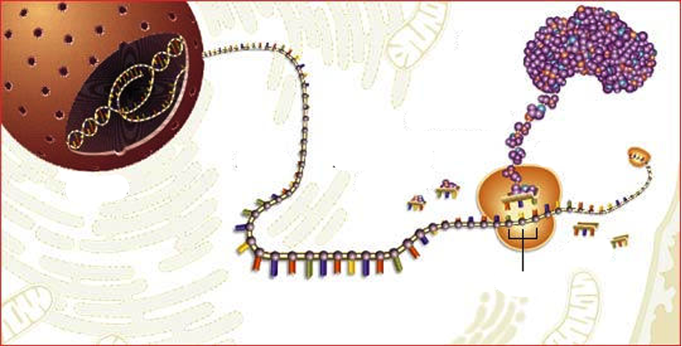
From DNA to Protein
mRNA
AAs
Ribosom
tRNA with AA
Codon
tRNA without AA
AA= AminoAcid
Notes:
PPT 11 Overview over the whole process
...later the single steps!!! (post it)

Slide 3
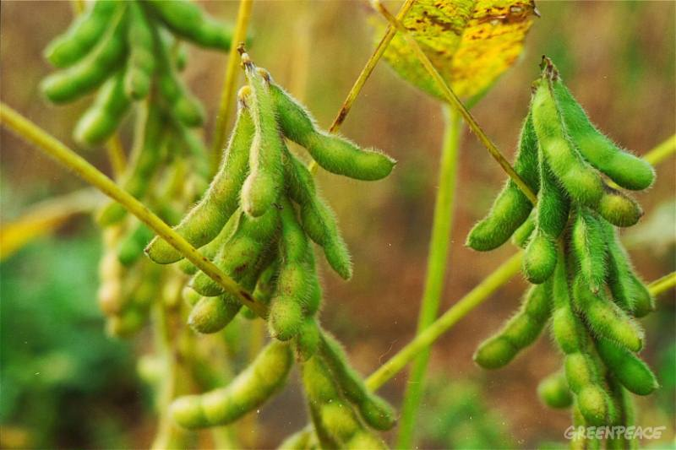
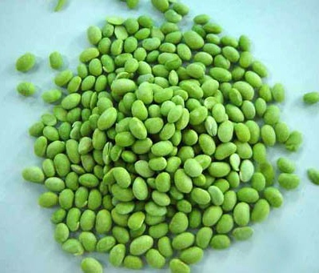
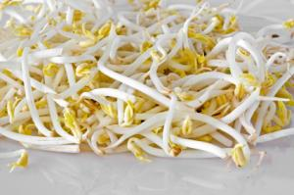
Soya beens contain all the essential Amino Acids (AA)

Slide 4
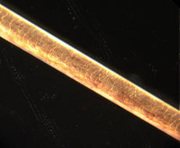
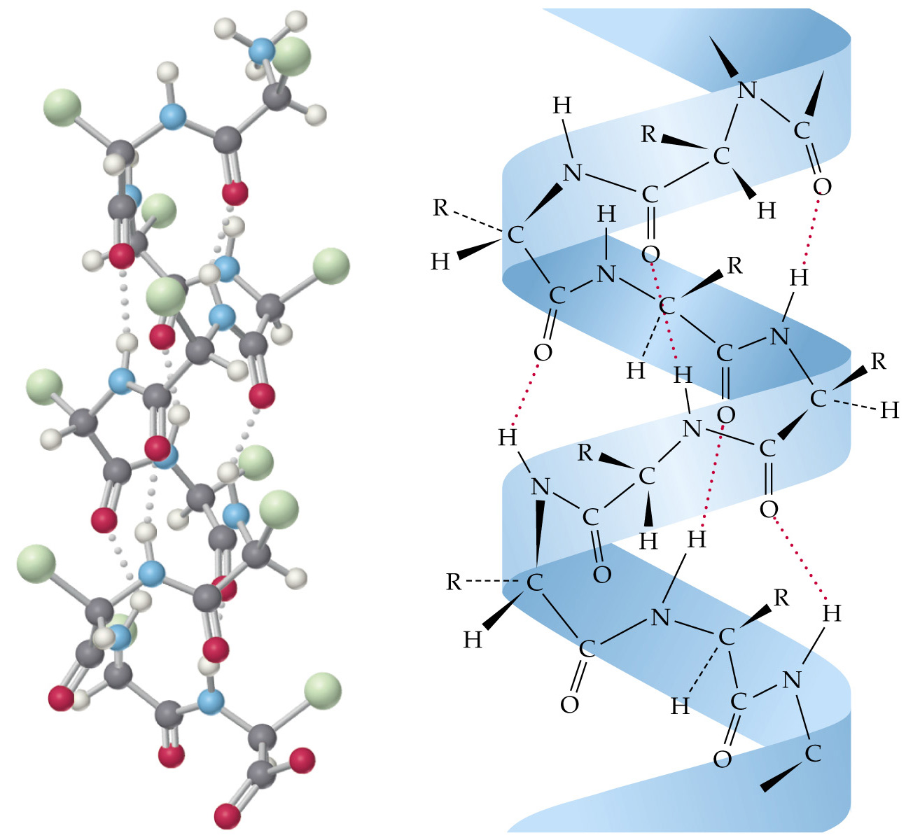
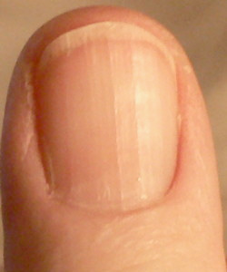
Structural Proteins: Example Keratin
Hair
Molecular structure of Keratin
Fingernail
Notes:
Structural proteins confer stiffness and rigidity to otherwise-fluid biological components.
Instructions to build this protein is stored in the DNA.

Slide 5
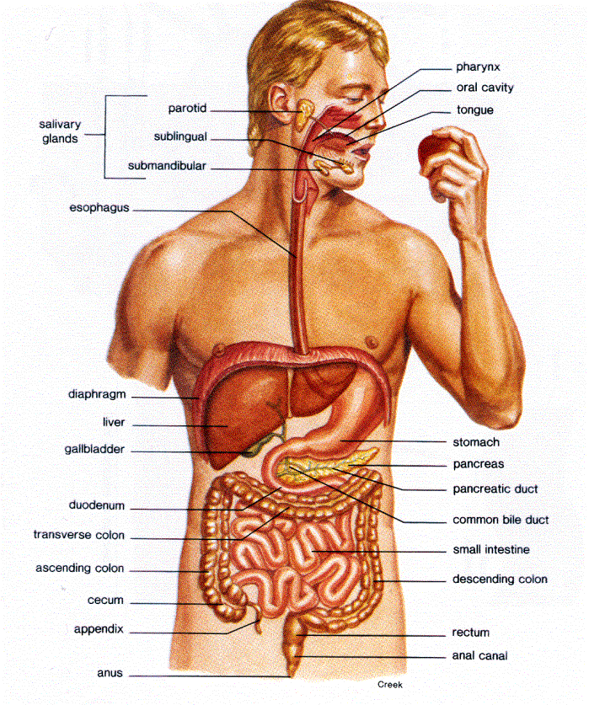
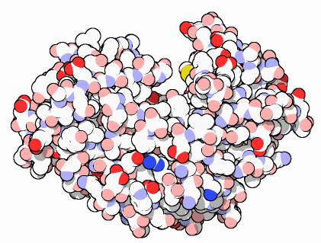
Proteins that control Chemical Reactions: Enzymes
Digestive Enzyme in the stomach
Example: Pepsin
Notes:
Photosynthesis/ Respiration other examples

Slide 6
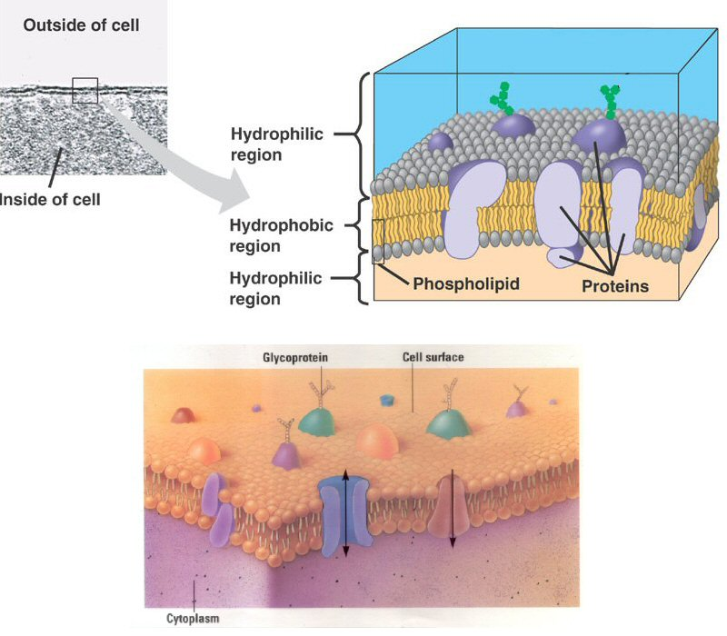
Cell Membrane Proteins:
→ Control of Transport into and out of the cell
Notes:
Cystic Fibrosis:

Slide 7
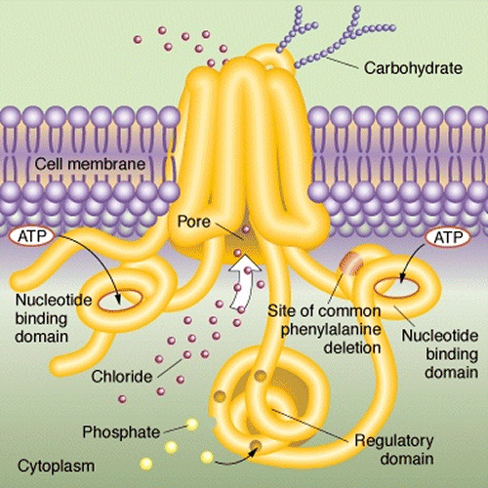
Example: Chlorid Channel

Slide 8
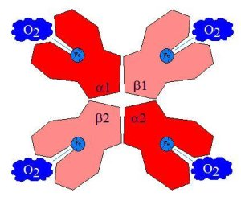
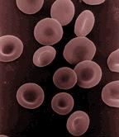
Transport Proteins:
Example: Haemoglobine
Red blood cell:

Slide 9
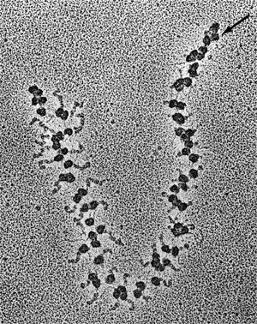
Many ribosomes translate a single mRNA at the same time

Slide 10
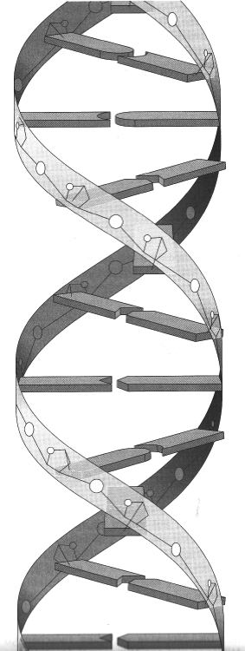
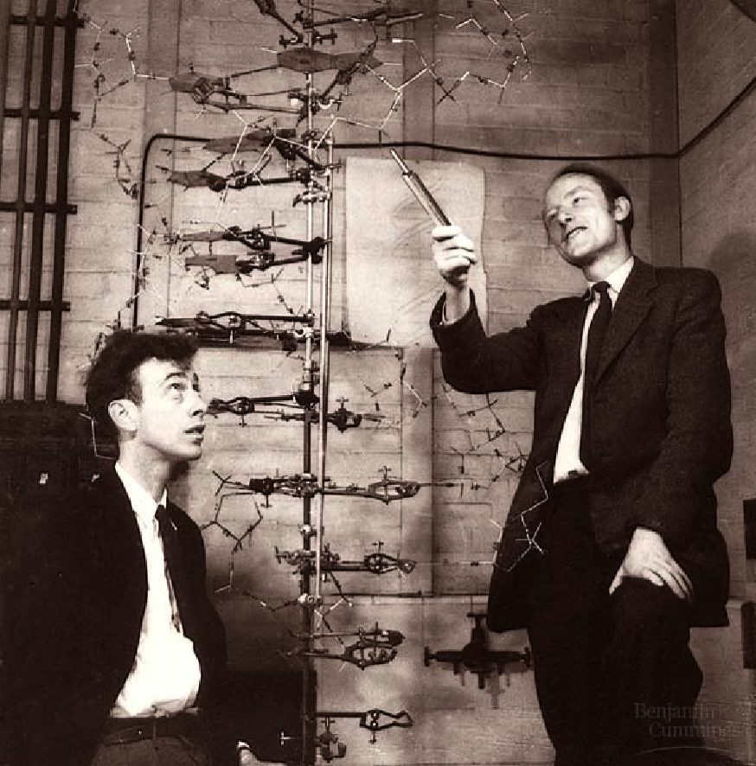
DNA
„Double Helix“
Watson and Crick 1953
→ Nobelprice in medicine

Slide 11
DNA

Slide 12
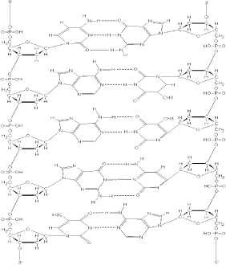
DNA: The molecule of life
5’ 3’
5’
3’

Slide 13
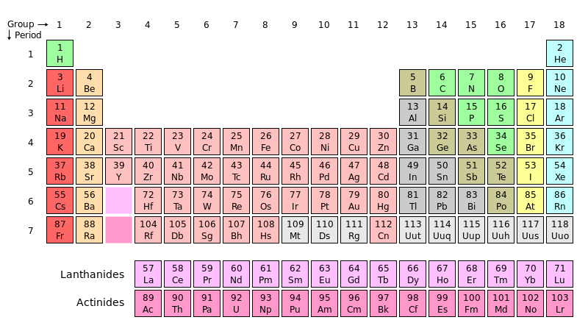
Periodic Table

Slide 15
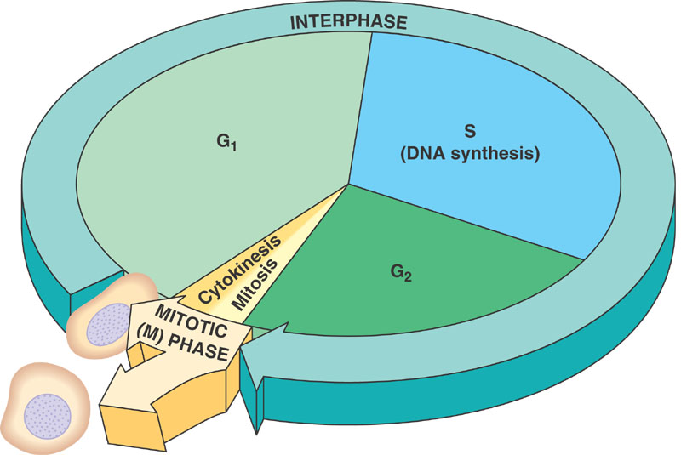
Cell Cycle

Slide 16
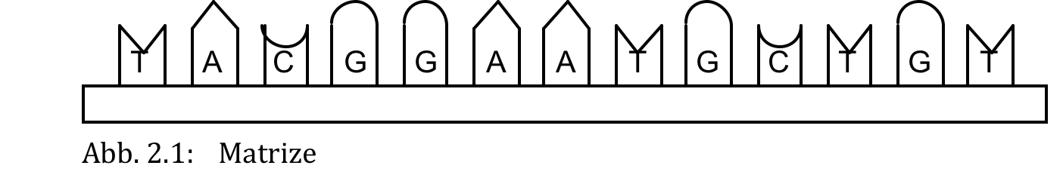
DNA Replication

Slide 17
The basic concept of DNA Replication
a)
b)

Slide 18
c)

Slide 19
d)

Slide 20
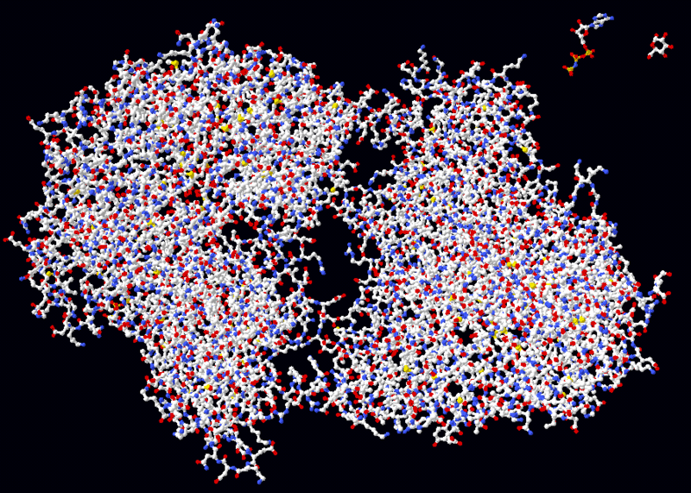
Helicase

Slide 21
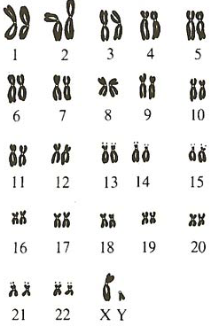
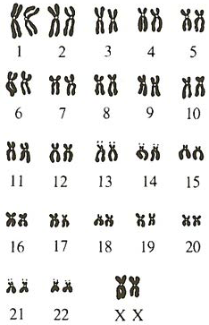
The 46 human Chromosomes
male
female

Slide 22
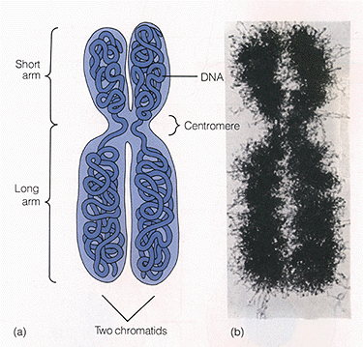
1 Chromosome

Slide 23
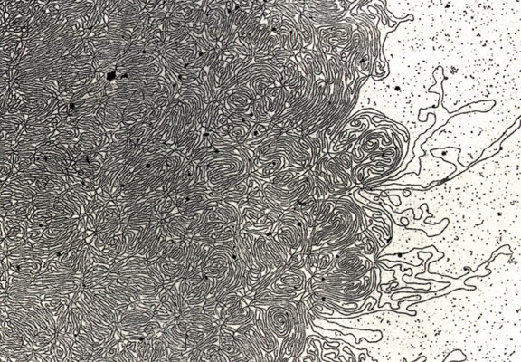
DNA- string

