Slide 1
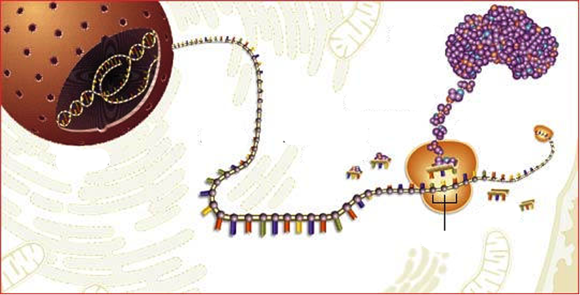
From DNA to Protein
mRNA
AAs
Ribosom
tRNA with AA
Codon
tRNA without AA
AA= AminoAcid
Notes:
PPT 11 Overview over the whole process
...later the single steps!!! (post it)

Slide 2
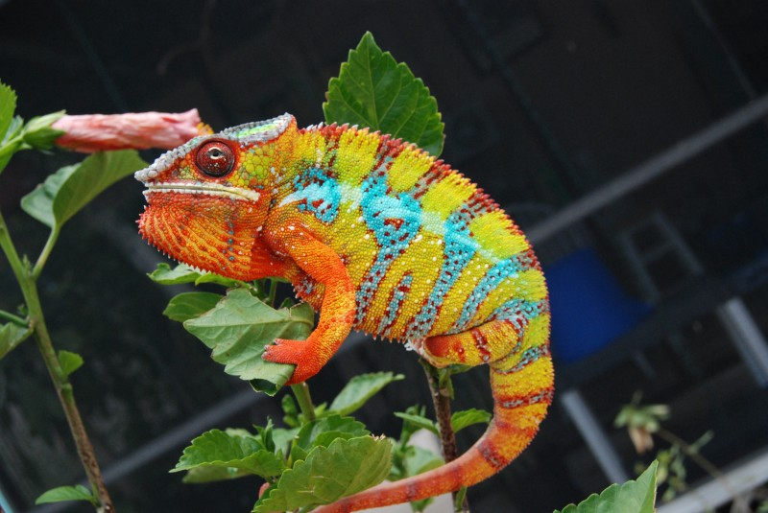
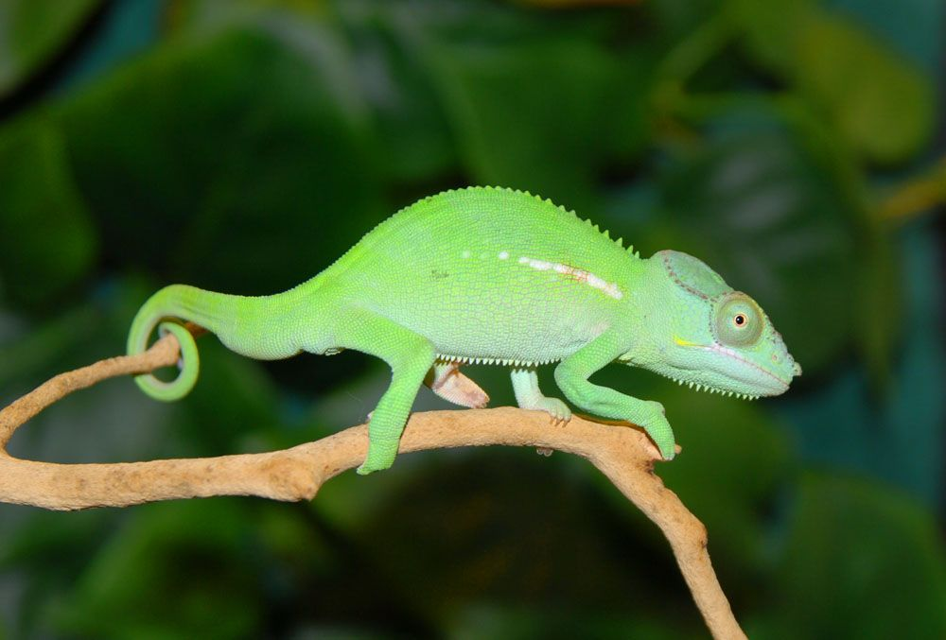
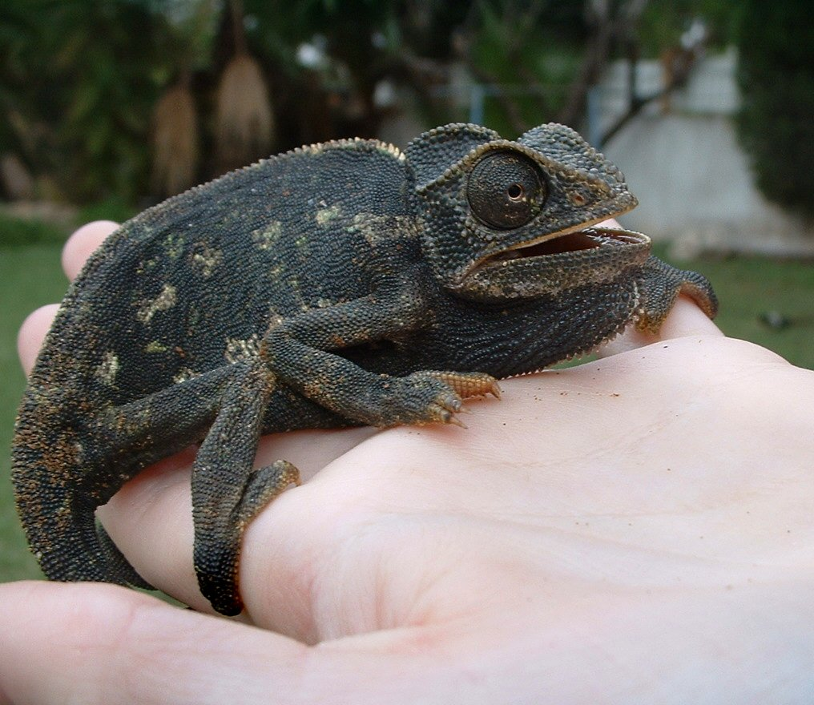
Chameleons

Slide 3
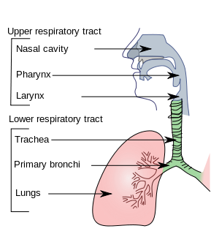
Viral Infections: Which cells affected? All?
„Common Cold“: Virusinfection

Slide 4
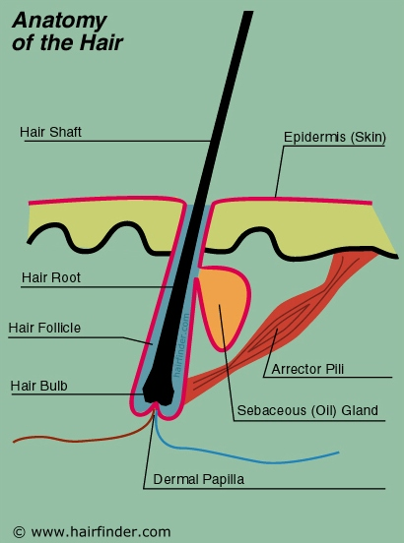
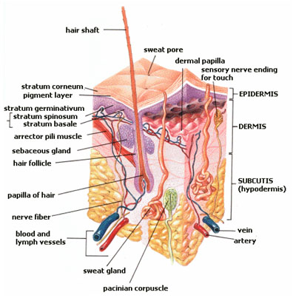
Hair

Slide 5
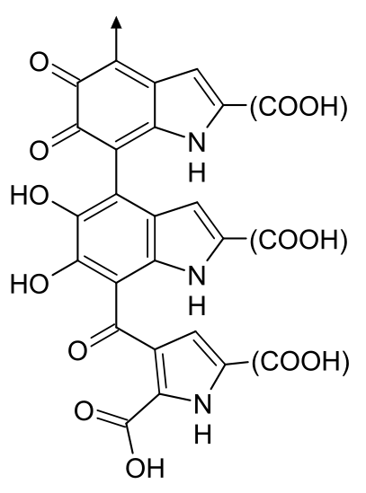
Melanine

Slide 6
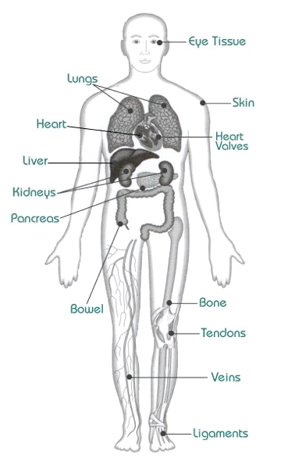
What organs (parts) can
be transplanted?

Slide 7
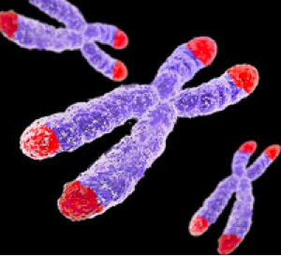
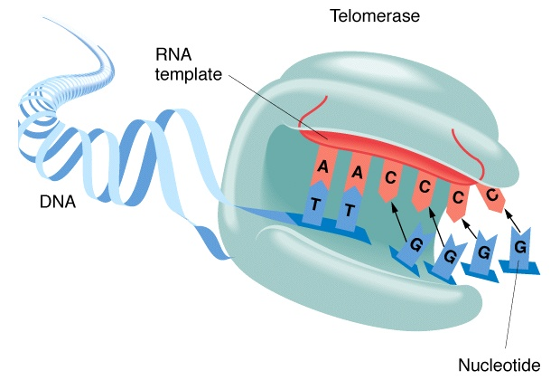
Telomerase

Slide 8
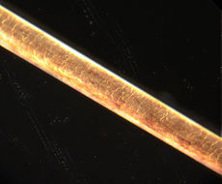
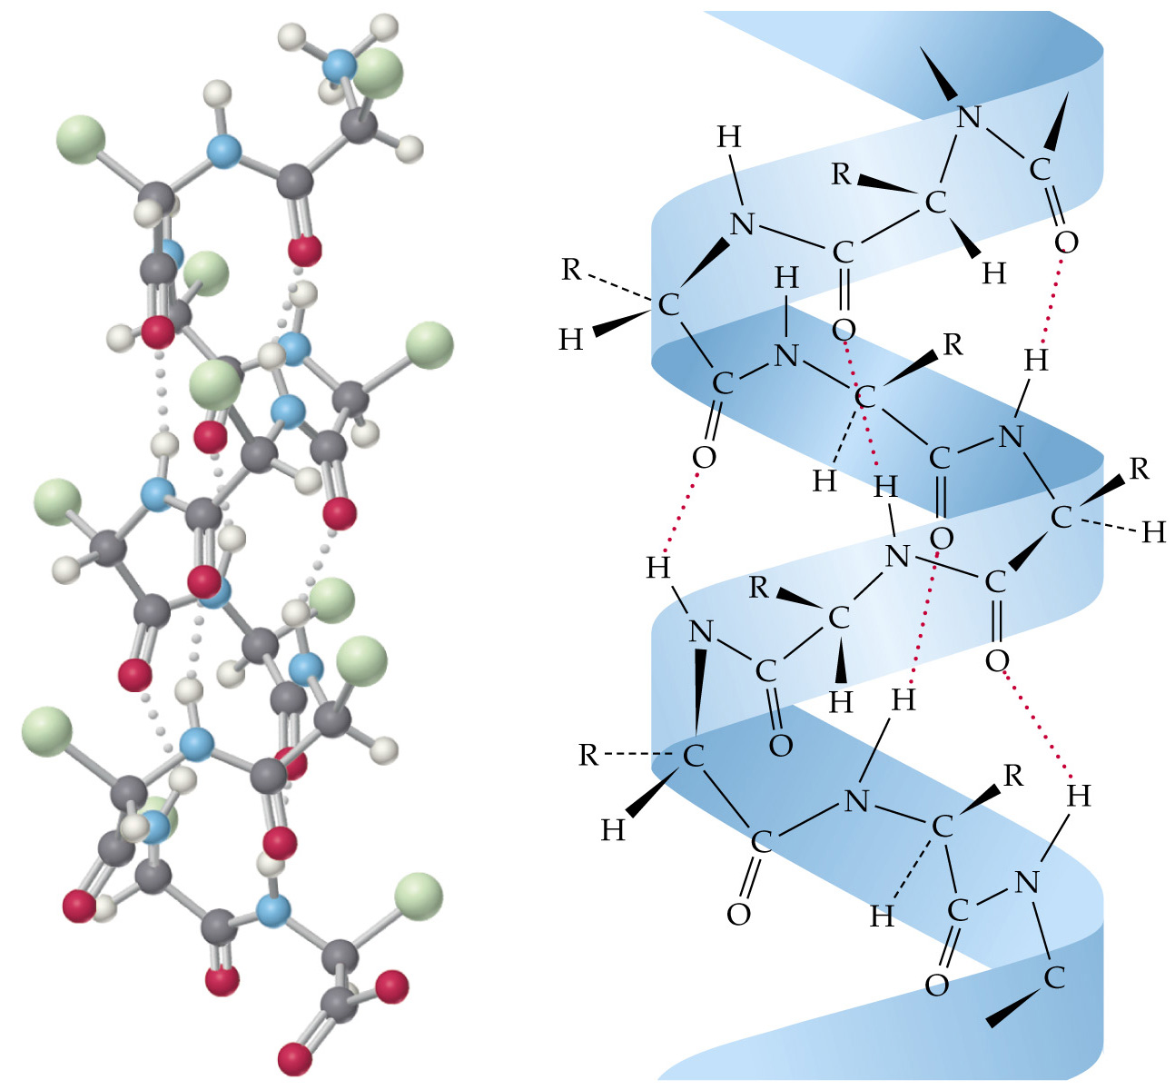
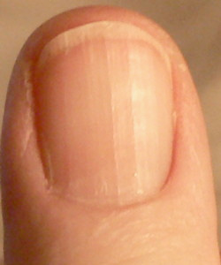
Structural Proteins: Example Keratin
Hair
Molecular structure of Keratin
Fingernail
Notes:
Structural proteins confer stiffness and rigidity to otherwise-fluid biological components.
Instructions to build this protein is stored in the DNA.

Slide 9
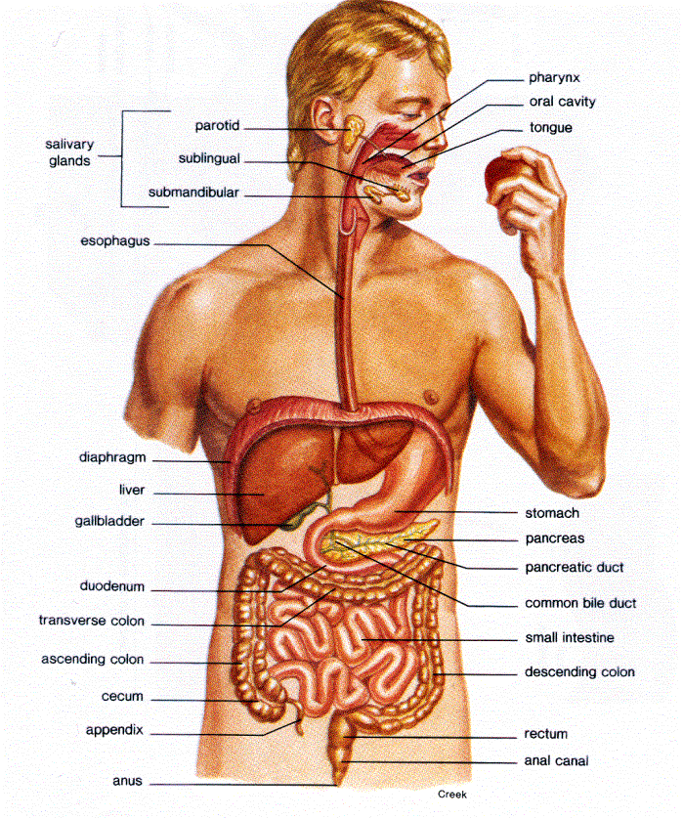
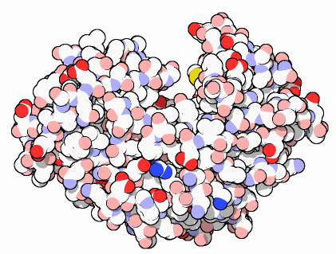
Proteins that control of Chemical Reactions: Enzymes
Digestive Enzyme in the stomach
Example: Pepsin
Notes:
Photosynthesis/ Respiration other examples

Slide 10
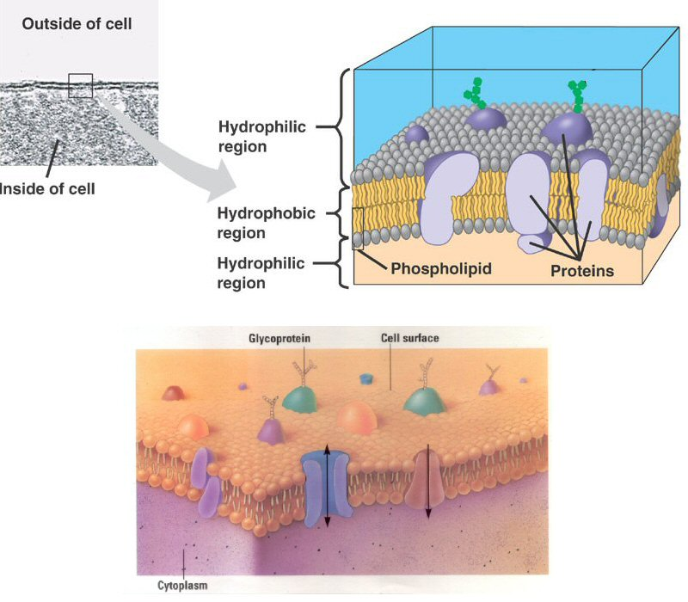
Cell Membrane Proteins:
→ Control of Transport into and out of the cell
Notes:
Cystic Fibrosis:

Slide 11
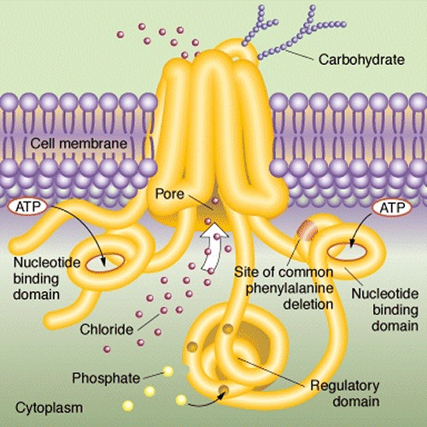
Example: Chlorid Channel

Slide 12
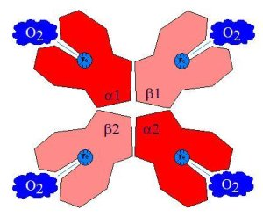
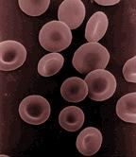
Transport Proteins:
Example: Haemoglobine
Red blood cell:

Slide 13
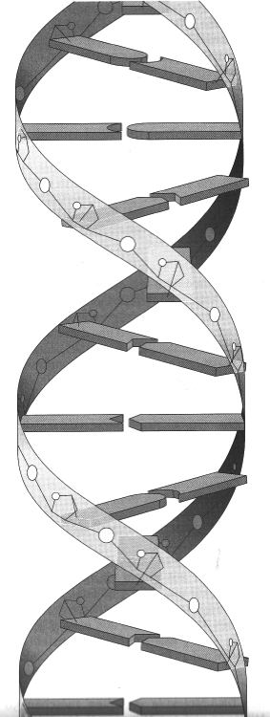
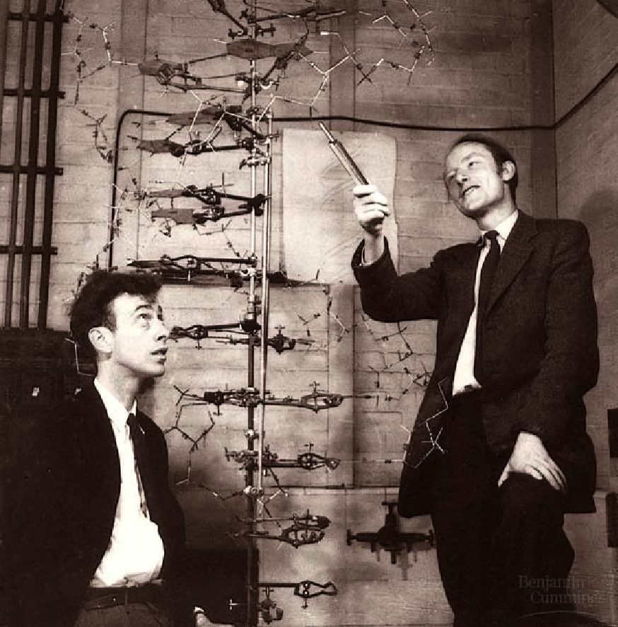
DNA
„Double Helix“
Watson and Crick 1953
→ Nobelprice in medicine

Slide 14
DNA

Slide 15
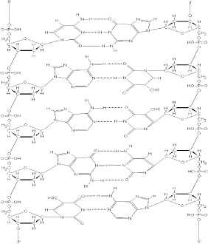
DNA: The molecule of life
5’ 3’
5’
3’

Slide 16
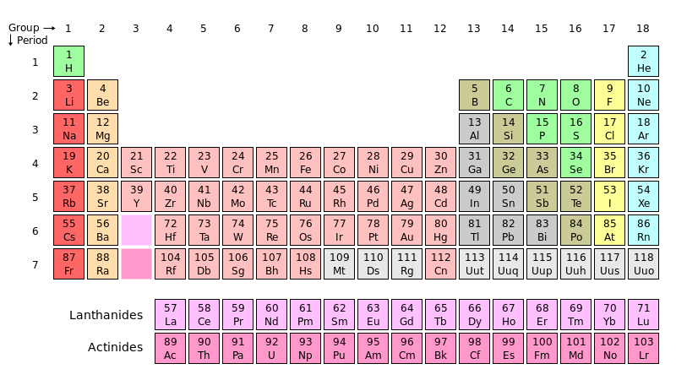
Periodic Table

Slide 18

Replication before Mitosis

Slide 19
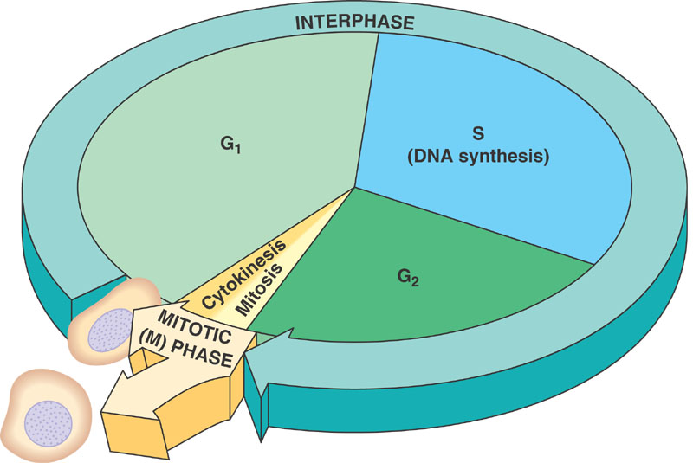
Cell Cycle
Notes:
interphase—during which the cell grows, accumulating nutrients needed for mitosis and duplicating its DNA
mitosis (M) phase, during which the cell splits itself into two distinct cells
cytokinesis, where the new cell is completely divided.

Slide 20
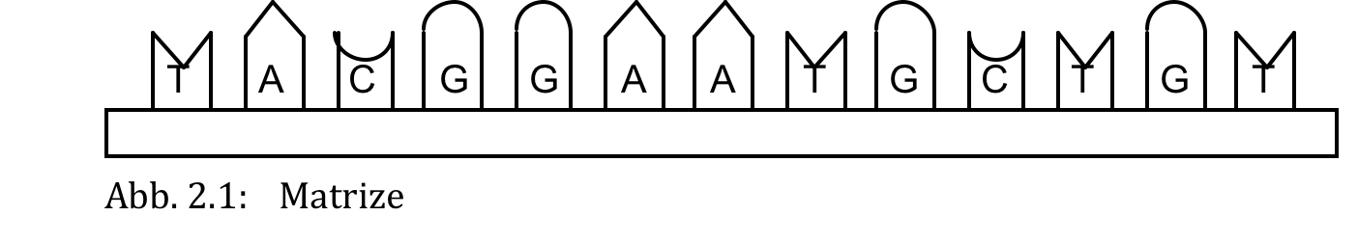
DNA

Slide 21
The basic concept of DNA Replication
a)
b)

Slide 22
c)

Slide 23
d)

Slide 24
Which result is correct?
A = G
b) A + G = C + T
c) A + T = G + T
d) A = C
e) G = T

Slide 25

3’
5’
DNA replication
(simple scheme)
③
①
②
5’
3’
5’
④
3’
⑤
⑤
3’
5’

Slide 26
Leading strand
DNA replication
(involved enzymes)
3’
5’
③
④
Direction of helicase
5’
②
①
3’
③
5’
⑤
⑥
Lagging strand
3’
5’

Slide 27
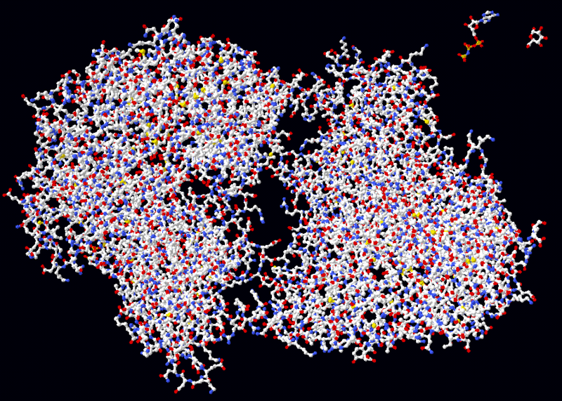
Helicase

Slide 28
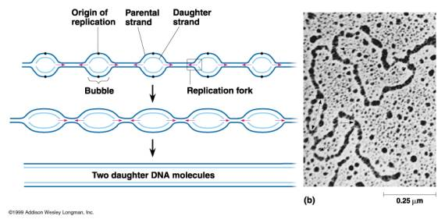
100- 1000 Origins of replication: eukaryotes

Slide 29
From gene to protein:
①
Transcription ④
②
Ala
Trp
Ser
② m-RNA
⑤ Translation
Glu
Ala
Ser
③
Ala
Leu
Val

Slide 30
Transcription: DNA → m-RNA
Transcription
Translation

Slide 31
Transcription of DNA
②
5’
3’
②
3’
5’
3’
①
5’
③

Slide 32
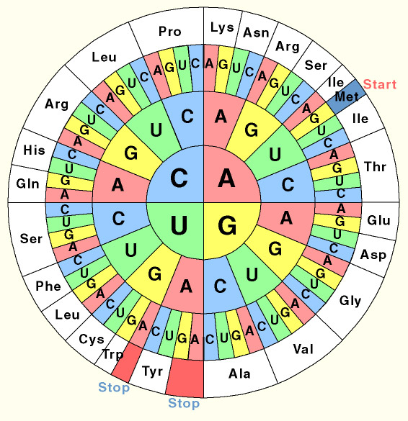
The Codon- Sun

Slide 33
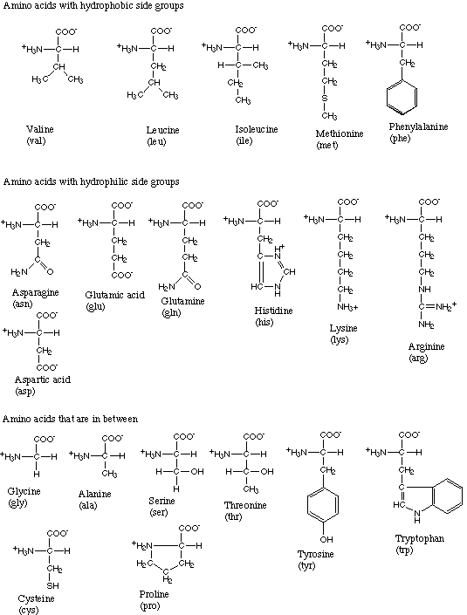

Slide 34
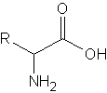
Amino acid

Slide 35
t- RNA
②
A
C
C
GA A
①

Slide 36
Stages of translation
A
Small subunit
m-RNA
5’
3’
U
U
AACCCA GCAAGACCCAA
U
ACGGAA
C
U
U
U
U
G
GGC
CGACCC A A
U
G
U
A C
Starter
t-RNA
MetMet

Slide 37
Stages of translation
B
5’
3’
AACCCAGCAACGACCCAA
U
ACGGAA
C
U
U
U
CGACCCAA
U
U
U
G
GGC
U
G
U
U
G G
A C
Met
Thr
Peptide bond

Slide 38
Stages of translation
C
The ribosome moves to the next base triplet
5’
3’
AACCCAGCAACGACCCAA
U
ACGGAA
C
U
G
U
GGC
U
CGACCCAA
G
U
U
U
U
U
G G
Thr
Gln
unloaded
t-RNA
Met

Slide 39
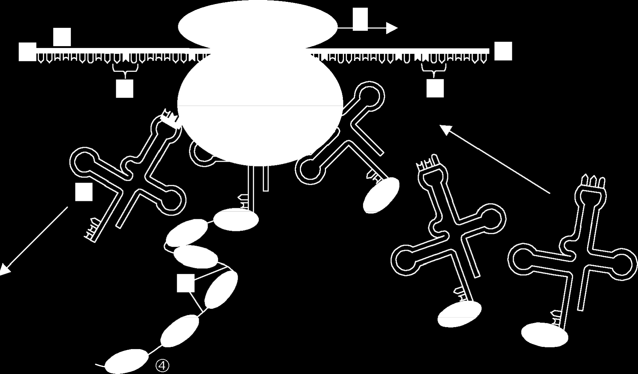
Translation: Overview

