Slide 1
135
46
a) What is the genotype of the purple parent plants?
b) What is the genotype of the 135 plants with
purple flowers?
Notes:
1) A farmer owns a field of pea plants with purple flowers. Sowing the seeds of these flowers he gets 135 plants with purple and 46 with white flowers.
a) Explain this result by drawing the scheme of the cross. Which allele is dominant?
b) What is the genotype of the purple parent plants?
c) What is the genotype of the 135 plants with purple flowers?

Slide 2
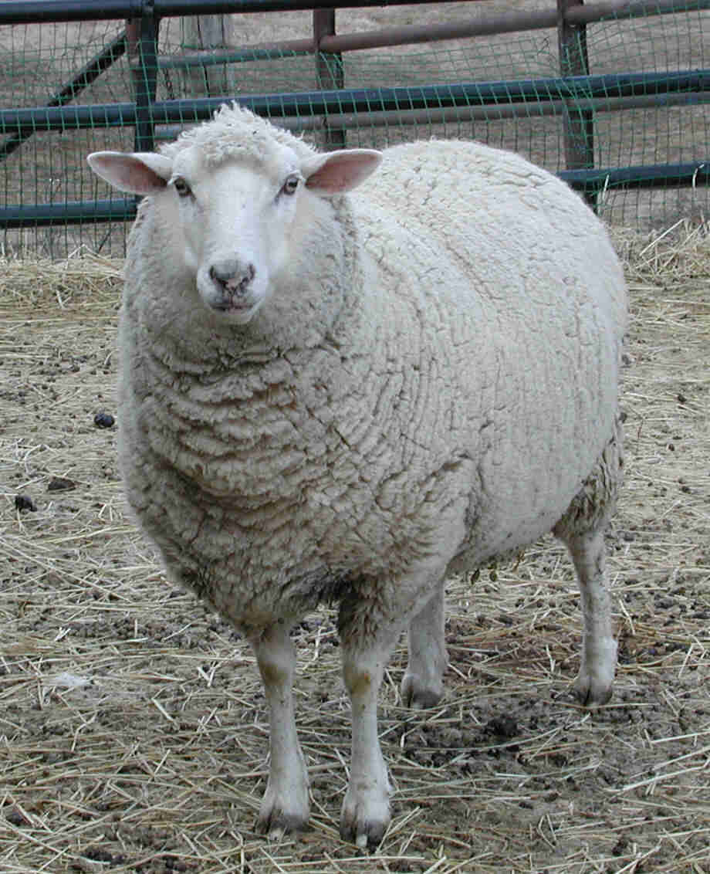
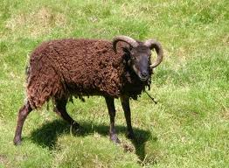
P:
F1: ?
?
F2:
?
<< 121
Notes:
. Ein reinerbig schwarzes Schaf paart sich mit einem reinerbig weissen Schaf und die
F₁-Generation wird „inter se“ weitergekreuzt. In der F₂ ist die grosse Mehrheit schwarz, nämlich
121 Schafe. Der Rest besitzt ein weisses Fell.
a) Welche Fellfarbe und welchen Genotyp hatte die F₁-Generation? Begründen Sie mit Hilfe der 2
Mendelschen Regel (welcher?).
b) Wie viele (ca.) weisse Schafe erwarten Sie in der F₂- Generation? Begründen Sie mit Hilfe 2
der Mendelschen Regel (welcher?).
c) Wie viele (ca.) schwarze Schafe in der F2 sind heterozygot? 1
d) Wie können Sie herausfinden, ob ein schwarzes Schaf heterozygot ist? (präzise Begründung) 2

Slide 3
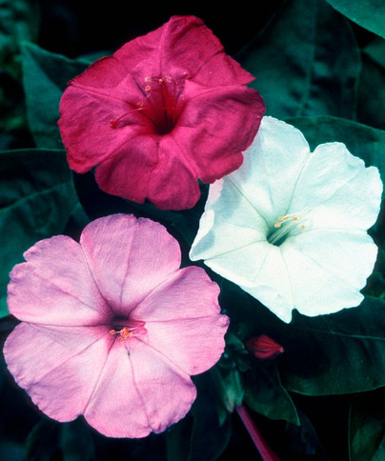
Incomplete Dominance: Four O‘Clock Flower
Notes:
Repetition: dominant recessive… only two phenotypes! Incomplete dominance: every genotype has ist genotype (3 different)
The flowers usually open from late afternoon onwards, then producing a strong, sweet-smelling fragrance, hence the first of its common names.
Parents red/white (homozygous)…. Offspring, red/ white/ pink. Any suggestions how this could have happened?
Apart from the “dominant-recessive” heredity that Mendel observed in his experiments, there also exist “incomplete dominance”. The phenotype of the heterozygous genotype is an intermediate of the phenotypes of the homozygous genotypes.

Slide 4
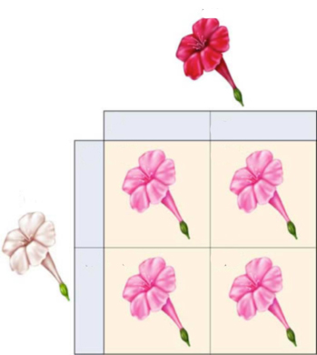
F1
F2

Slide 5
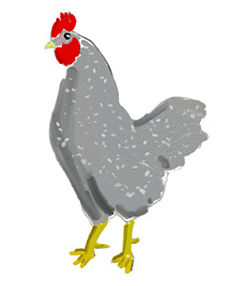
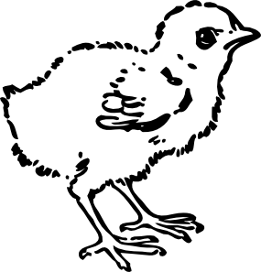
Try to explain this Result:
grey
grey
9
16
7
white
grey
black

Slide 6
C^{B}C^{W}
C^{B}
C^{W}
C^{B}
C^{B}C^{B}
C^{W}C^{B}
C^{B}C^{W}
C^{W}
C^{W}C^{B}
C^{W}C^{W}
Ratio: 1 (black) : 2 (grey) : 1 (white)
Notes:
What is the genotype of the parents? C^{B}C^{W} „Erscheinen“
What germ cells do they produce...or which genes can they give to the offspring? C^{B} or C^{W} „Erscheinen“
3. What are the genotypes of the offspring? Oben links beginnen „Erscheinen“
4. What are the phenotypes of the offspring? Oben links beginnen „Erscheinen“

Slide 7
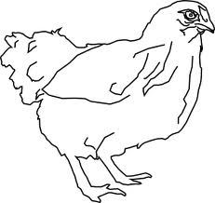
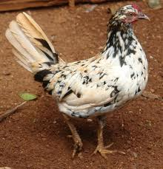
Codominance
C^{W}C^{W}
C^{B}C^{B}
C^{W}C^{B}
Offspring (C^{W}C^{B}) is not intermediate (grey), but with white and black areas.
Notes:
How would the offspring of a cross between a red and white flower look like, if the trait was inherited in a codominant way?

Slide 8
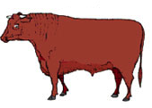
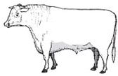
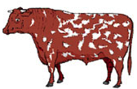
Dominant recessive, incomplete dominance or codominance?
P:
F1:
F2:
Notes:
Codominance
If you cross the F1- cows with each other.... What does the offspring look like? Draw the punnet square!

Slide 9
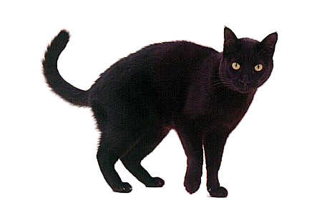
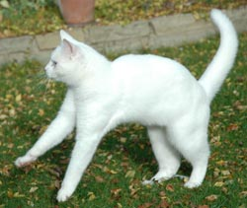
Black fur is dominant over white fur: Is the following outcome of a cross possible?
Notes:
If they have 7 puppies... How many of them do you expect to be white?

Slide 10
Repetition:
Read in the Bokk „Evolution on page Nr. 48/49 untill page Nr. 50/51
Notes:
Before going on... If problems: read text book evolution on page nr.48/49 middle „Mendel... Untill page nr. 50/ 51

Slide 11
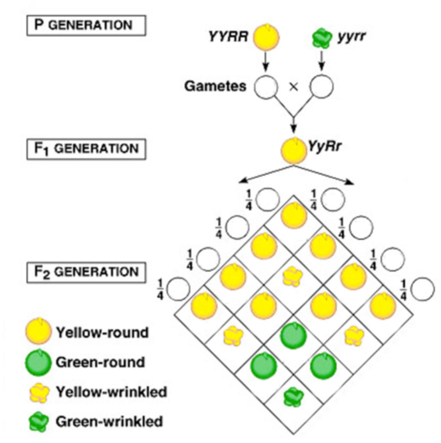
Inheritance of two Traits: Colour and Shape
Notes:
Third Law: Looking at a cross with two or more traits involved, the genes for the separate traits are passed independently of one another from parents to offspring. = „Law of Independent Assortment”

Slide 12
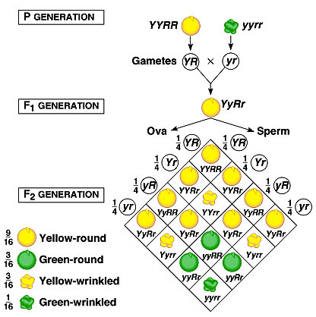

Slide 13
Heredity and Chromosomes

