Slide 1
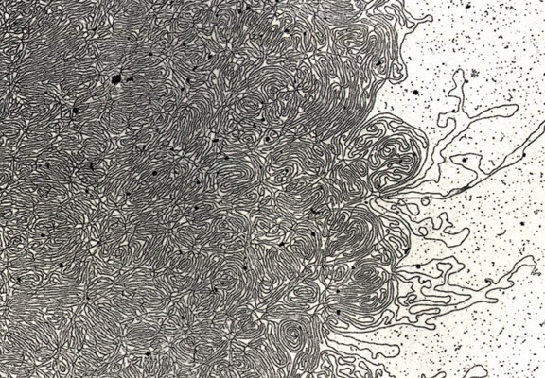
DNA- „Thread“

Slide 2
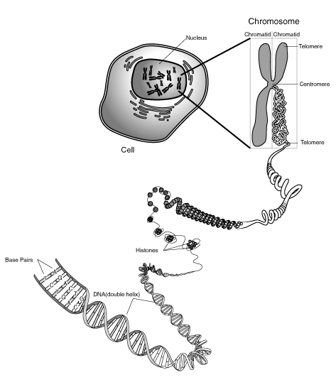
Notes:
Skin, muscle, and nerve cells are some examples of human somatic cells. They display a big variation in form and function, but all of them store their genetic information in the cell nucleus. Structures, called chromosomes, are the carriers of this information. They consist of a long, very thin „thread“ of DNA, in which this information is encoded.

Slide 3
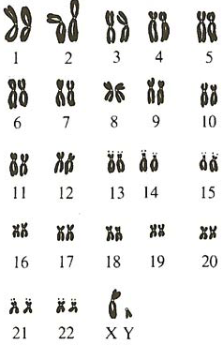
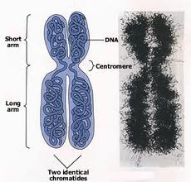

Slide 4
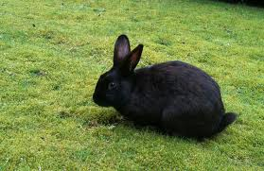
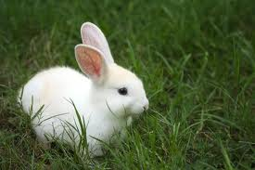
Rabbit Family Tree
? %
Notes:
Explain scheme
...let them try for some time!!!
Procedure:

Slide 5
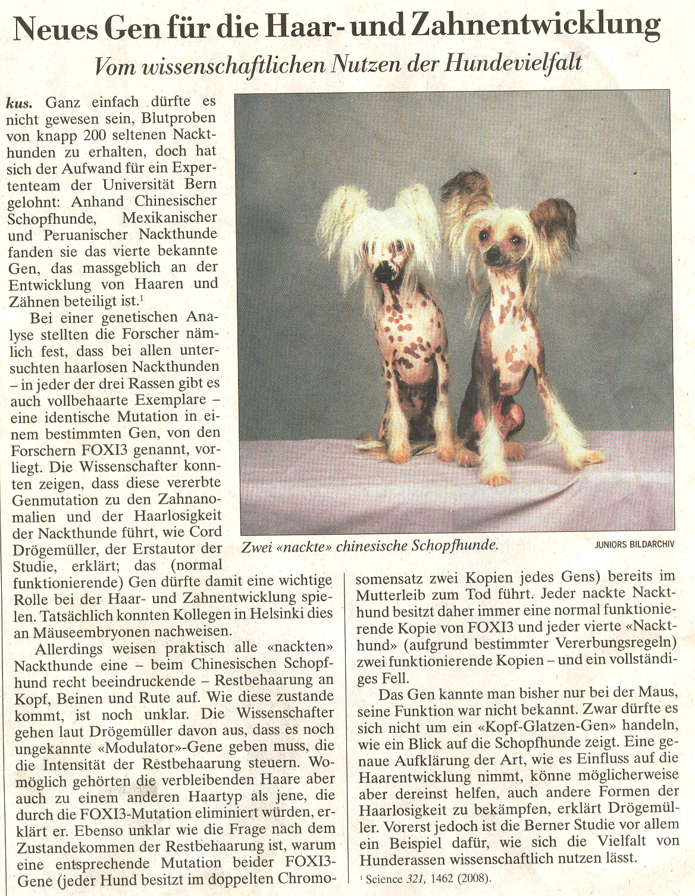

Slide 6
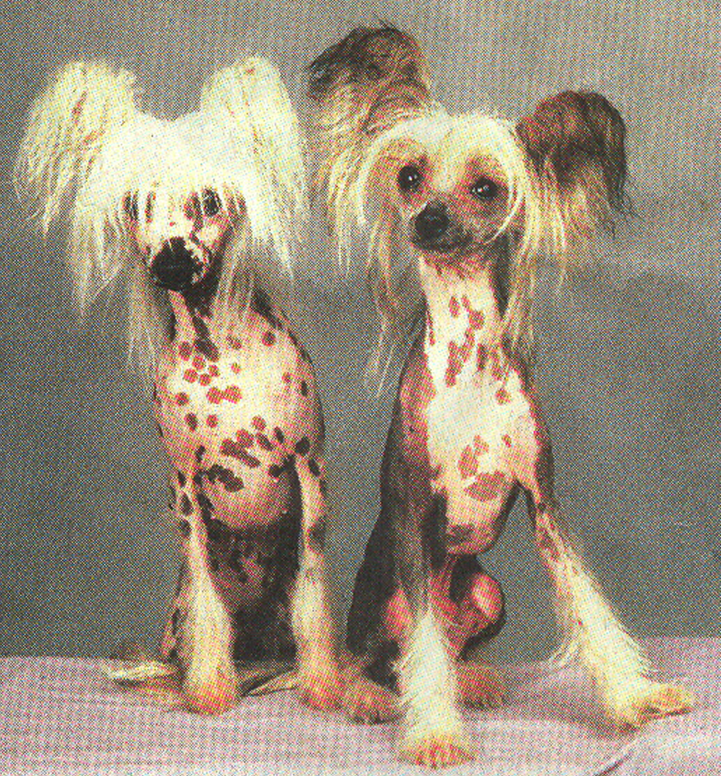
Notes:
Gene: FOXI13... Responsible for development of teeth and hair.... „Chinese naked dogs“. These dogs have only very little hair and many teeth problems.
Some people have strange taste (I would say) and pretend this as beautiful.
1) Dogs possess one copy of FOXI13 (and on „normal“ allele).... Dominant or recessive? FOXI13 is dominant.
Homozygous FOXI13 dogs die in the mothers womb.
2) In a cross between two of these dogs. How many percentage of the puppies do you expect to have normal hair and teeth?
Draw the punnett square!!!
33%... 1/3 (1/4 already dies in the mothers womb!!!)
3) What do you think of the fact that people are breeding these dogs?

Slide 7
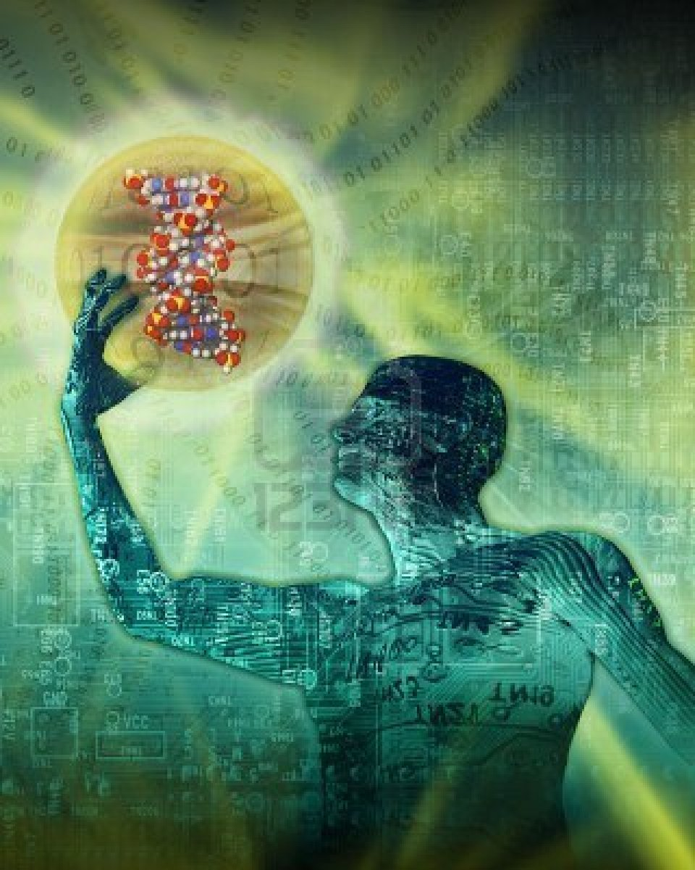
Human Genetics
Model of
DNA Molecule
Notes:
As in pea plants the visible traits (i.e. eye colour) and the invisible traits (i.e. blood groups) are inherited through the genes (specifique sequences of DNA), organised in chromosomes

Slide 8
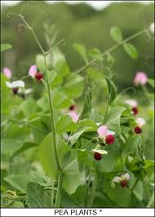
Pea Plant
Fruit fly
Notes:
Human beings are much more familiar to us as peas or flies. Diseases affecting the human interest us much more than disease, which, affect peas. Also, physiology of a human being is much more complicated than the physiology of a fruit fly.
Still the basic principles of heredity in pea plants, flies and humans are the same!!!
DNA, is the carrier of the genetic information (= genes) organised in chromosomes.
Mitosis and Meiosis happens in the same way
The Language how this information is translated into proteins is the same… we will see in molecular Genetics.
Still… as humans we are much more interested in the hereduty of humans.
What could be the reasons why we study these organisms?
Easy to keep… little space needed… the overall cost is low.
It has a short generation time (about 10 days at room temperature) so several generations can be studied within a few weeks.
c) It has a high fecundity (females lay up to 100 eggs per day, and perhaps 2000 in a lifetime)
Ethical reasons inhibit to do experiments with humans (animal experiments also questionable!!!)... but still one gain insight (about dominant/recessive... and more) in the heredity of traits and certain deiseases by just looking at families and in which pattern these traits appear in families over generations.

Slide 9
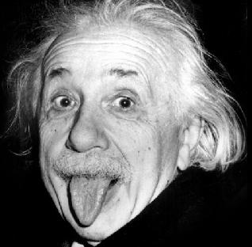
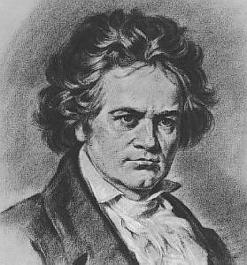
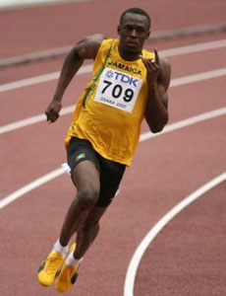
Exceptional Talents:
Genetics AND Environment (=Training)
Science
Music
Sports
Einstein
(1879- 1955)
Beethoven
(1770- 1827)
Bolt
(1986- )
Notes:
Talents: Science, Sports (i.e. Usan Bolt), Music, ...genetical constitution as a basis, afterwards training
Almost in the development of every trait there is a little bit of both, genetical contribution and influence from the environment. Sometimes the genetical influence predominates, sometimes the influence from the environment.
Such talents/ traits are influenced by many genes that act in a very complicated way together… difficult to investigate!!!

Slide 10
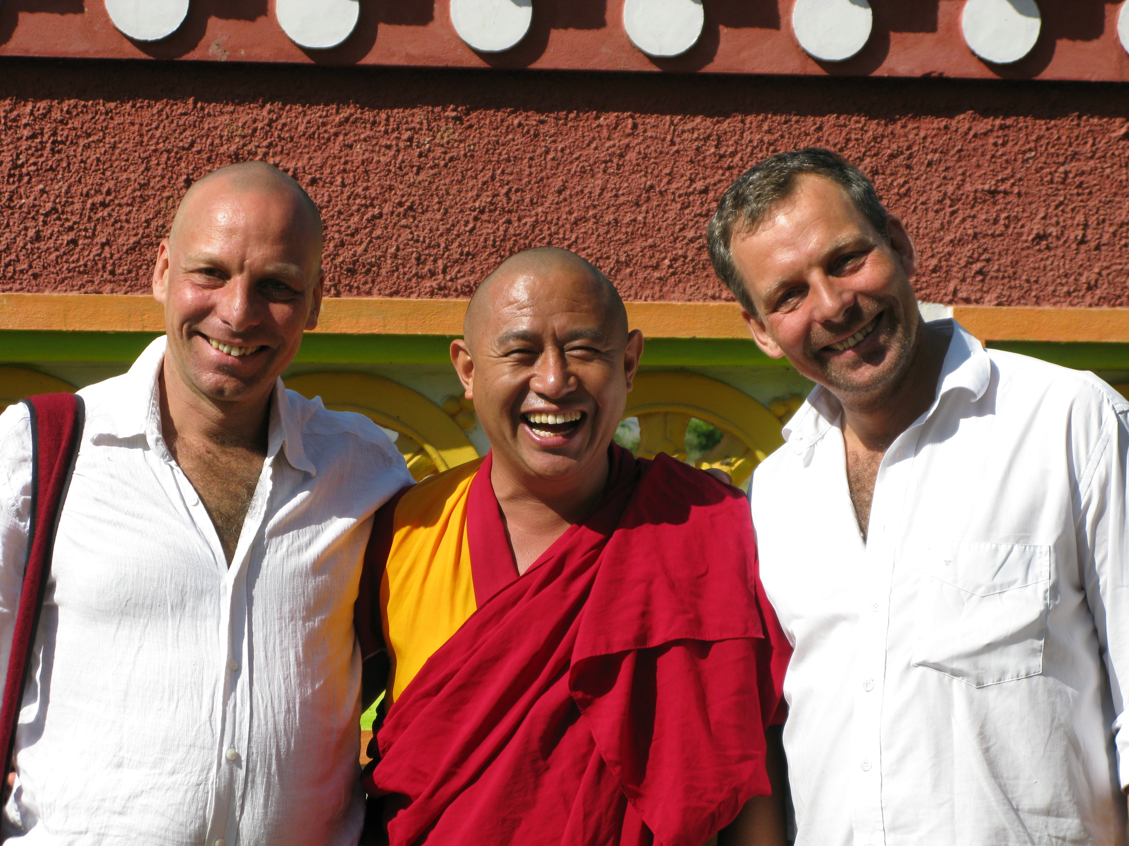
Identical Twins= Genetically identical
Frank Geshe Samten la Lutz (Franks Brother)
Notes:
Twin research (identical twins) to study the influence of the environment on a certain trait... Genes the same!!!
The best if they were brought up under completely different environments. If you look at a certain feature and it is absolutely identical... one can say it is geneticaly determined.
Intelligence...

Slide 11
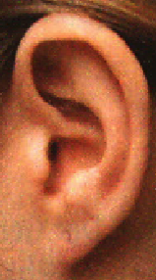
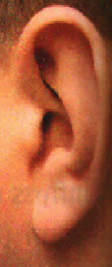
Shape of the earlobe
→ monogeneous
„basisfixed“
„free“
Notes:
While describing me, most of the traits you mentioned were polygenic ... Body height, skin colour.... and also influenced by the environment.... characteristics.
But there are traits that are only defined by a single gene. First we want to look at these and how they are transmitted from one generation to the next. These are just natural variaties among people.
After this we will have a look at diseases that are caused by a single gene.

Slide 12
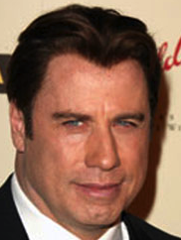
Widow‘s peak
→ monogeneous

Slide 13
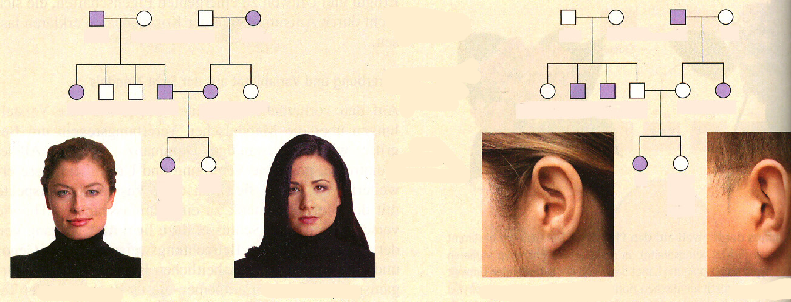
Dominant or Recessive?
1
2
3
4
1
2
3
4
5
6
7
8
9
10
5
6
7
8
9
10
11
12
11
12
Notes:
Explain: male/ female

Slide 14
dominant
recessive
1
2
3
4
1
2
3
4
Ww
ww
ww
Ww
Ff
Ff
ff
Ff
FF
5
6
7
8
9
10
or
5
6
7
8
9
10
Ww
ww
Ww
Ww
ww
ww
Ff
ff
ff
Ff
Ff
ff
11
12
11
12
WW
ww
ff
FF
or
or
Ff
Ww
W
w
f
F

Slide 15
Sex-linked Heredity

Slide 16
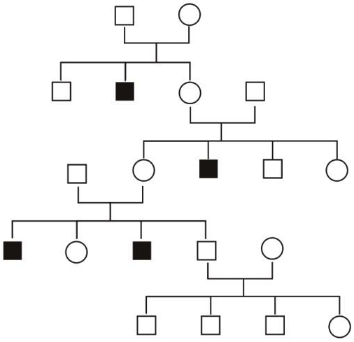
XY
XX
XY
XY
XX
XY
XY
XX
XY
XY
XX
or
XX
XX
or
XX
XY
XX
or
XX
XY
XY
XX
or
XX
XY
XY
XY

