Slide 1
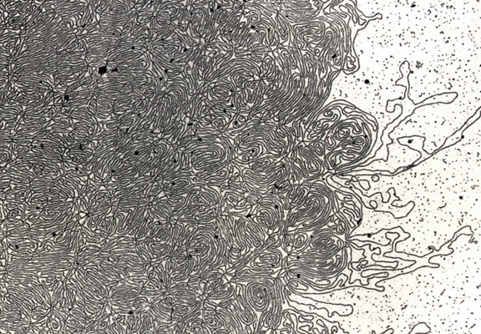
DNA- „Thread“

Slide 2
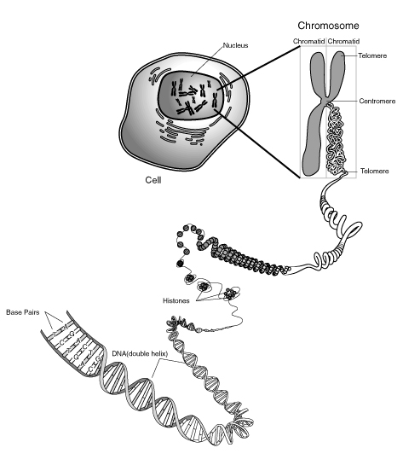
Notes:
Skin, muscle, and nerve cells are some examples of human somatic cells. They display a big variation in form and function, but all of them store their genetic information in the cell nucleus. Structures, called chromosomes, are the carriers of this information. They consist of a long, very thin „thread“ of DNA, in which this information is encoded.

Slide 3
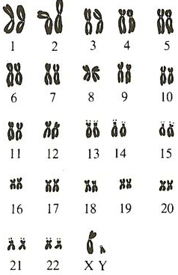
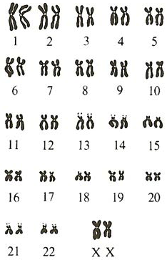
The 46 Human Chromosomes
Male
Female
Notes:
Sex-linked heredity: show if gene on X defect... Male can not compensate with second X.... Females can!!!
In females recessive... only if two copies defective.

Slide 4
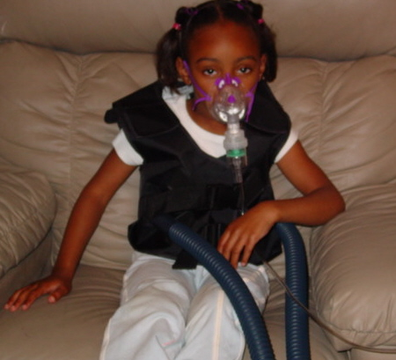
Human Genetic Disorders
Cystic Fibrosis:
- Monogenous
Autosomal
Recessive

Slide 5
Exercise
Imagine you would be a counsellor giving advice to a couple which is thinking of having a baby.
Carl was already married to another woman and they had a baby with cystic fibrosis.
The Brother of his present woman Helen died of cystic fibrosis.
ཁྱོད་རང་སློབ་སྟོན་པ་གཞི་ཡིན་པའི་ཚོད་དཔག་བྱེད་ནས་བཟའ་ཚང་ཕྲུ་གུ་དགོས་འདོད་པ་གཞི་ལ་བསླབ་བྱ་སྤྲོད།
ཀྲརལ་ནི་སྐྱེས་མ་གཞན་གཞི་མཉན་དུ་གཉེན་སྒྲིག་ཟིན་པ་དང་ཁོ་ཚོ་ལ་ཕྤུ་གུ་ གྲོད་ཁུག་གི་རྩ་རྒྱུས་སྐྲངས་ནད་པ་གཞི་ཡོད།
ད་ལྟ་ཁོ་རང་གི་སྐྱེས་མ་ཧ་ལེན་གྱི་གཅེན་པོ་གྲོད་ཁུག་གི་རྩ་རྒྱུས་སྐྲངས་ནད་ནས་འདས་གྲོངས་བྱིན།

Slide 6
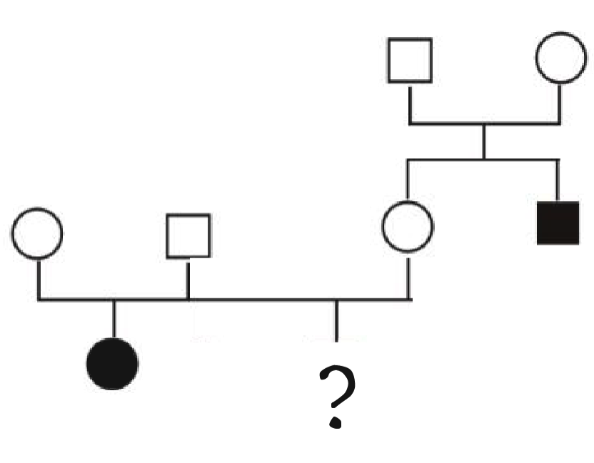
How big is the chance for them to have a baby with cystic fibrosis? _______________
ཁོ་རང་གཉིས་ལ་གྲོད་ཁུག་གི་རྩ་རྒྱུས་སྐྲངས་ནད་ཡོད་པའི་ཕྲུ་གུ་ཉེན་ཁ་ཇི་ལྟར་ཆེན་པོ་ཡོད་དམ། _______________
c = cystic fibrosis allele
C = normal allele
Cc
Cc
Carl
Helen
CC
or
Cc
Cc
Cc
cc
cc

Slide 7
P (Cc): 2/3
Genotype of Helen ?
Father Mother | C | c
C | CC | Cc
c | Cc | cc

Slide 8
P (cc): 1/4
Child with Cystic Fibrosis
Carl Helen | C | c
C | CC | Cc
c | Cc | cc

Slide 9
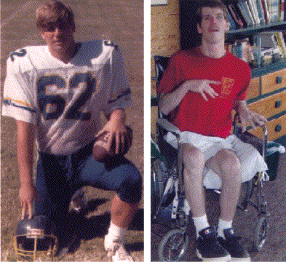
Chorea Hutington Patient
- monogenous
- autosomal
- dominant
18 years
33 years

Slide 10
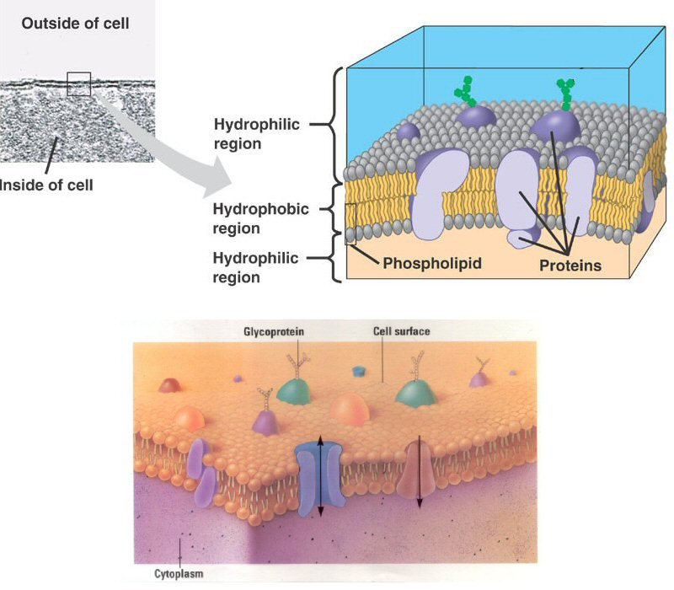
Cell membrane proteins:
→ control of transport into and out of the cell

Slide 11
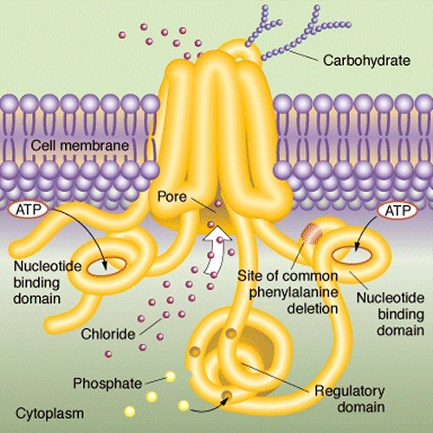
Chlorid channel

Slide 12
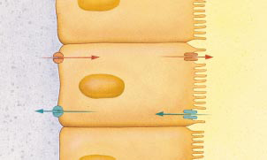
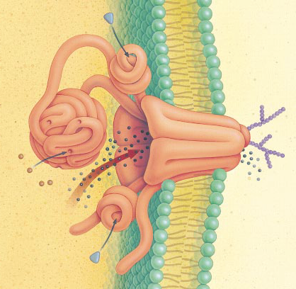
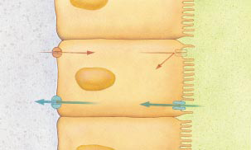
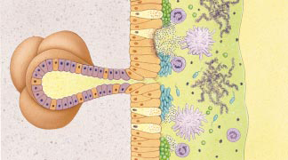
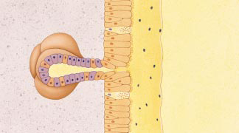
Effect on Lungs
Chloride channel
transports salt through protein channel out of cell
Osmosis: H₂O follows Cl–
normal lungs
airway
Cl–
Cl– channel
H₂O
cells lining lungs
cystic fibrosis
Cl–
H₂O
bacteria & mucus build up
thickened mucus hard to secrete
mucus secreting glands

Slide 13
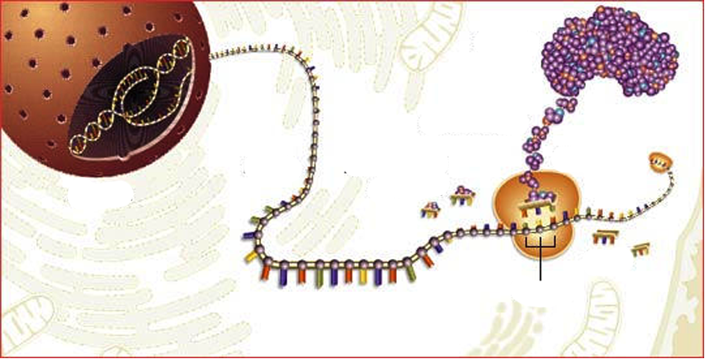
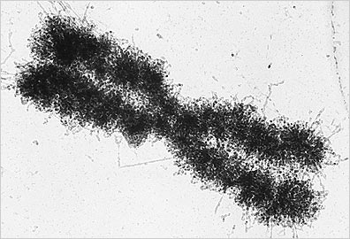
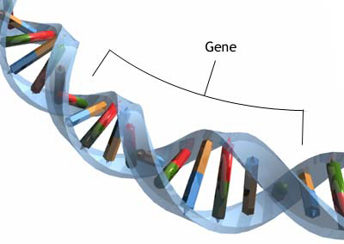
MOLECULAR GENETICS
Notes:
QUESTION: What is this gene or element underlying the realization of a particular trait?
MOLECULAR GENETICS

Slide 14
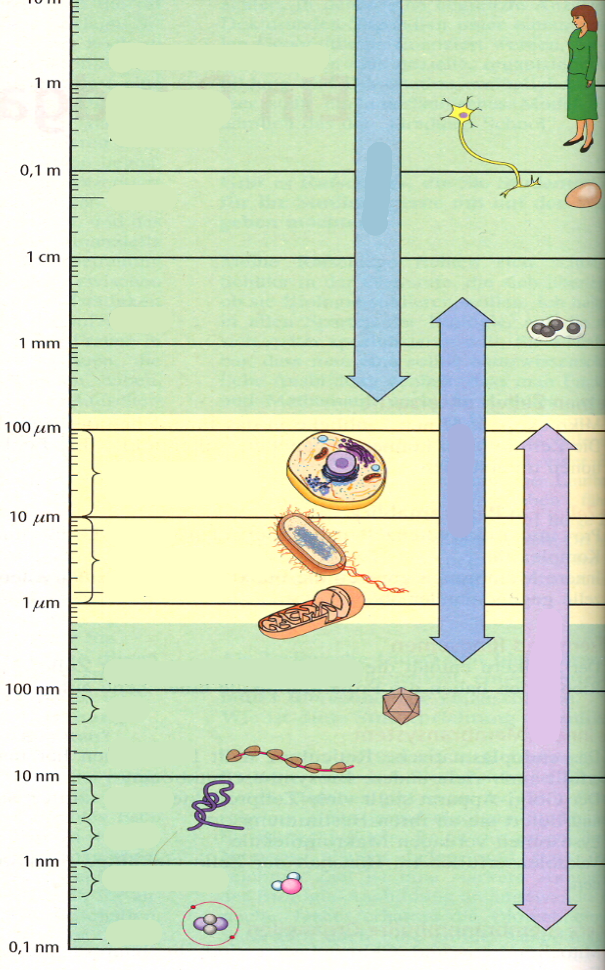
Dimensions:
Notes:
Explain the figure to the right: Fill in Microscopes!!!
„What happens when we change from one section to the next one further below?“
The scale indicates a distance ten times smaller than te one before!!!
...classical genetics cell nucleus (chromosomes).... Now talking about much smaller dimensions!!!
Molecular genetics: Cell... Cell nucleus... Chromosomes... DNA (long thread chromosomes are made of)... Looking at sections of DNA... genes

Slide 15
From DNA to Protein

Slide 17
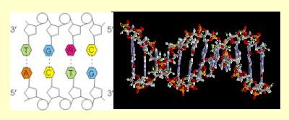

Slide 18
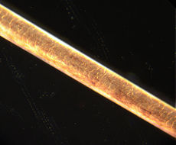
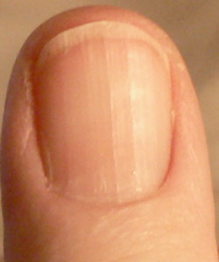
Structural protein: f.e.Keratin
Hair
Fingernail

Slide 19
Enzymes (proteins): Control of chemical reactions
Example:
Photosynthesis + Respiration

Slide 20
Cell membrane proteins:
→ control of transport into and out of the cell

Slide 21
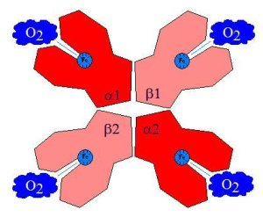
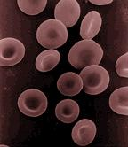
Transportproteins:
Example:
Haemoglobine
Red blood cell:

