Slide 1
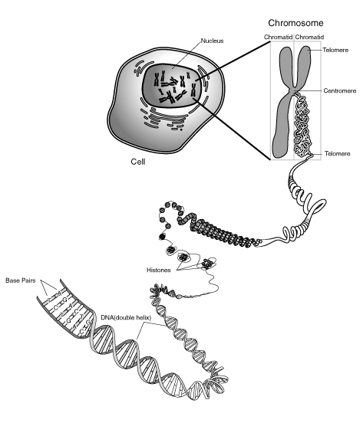
Notes:
DNA

Slide 2
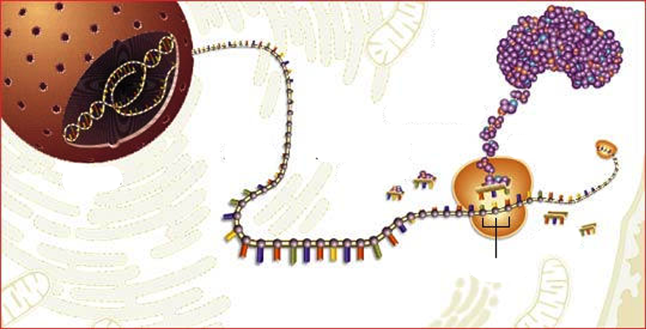
From DNA to Protein
mRNA
AAs
Ribosom
tRNA with AA
Codon
tRNA without AA
AA= AminoAcid
Notes:
PPT 11 Overview over the whole process
...later the single steps!!! (post it)

Slide 3
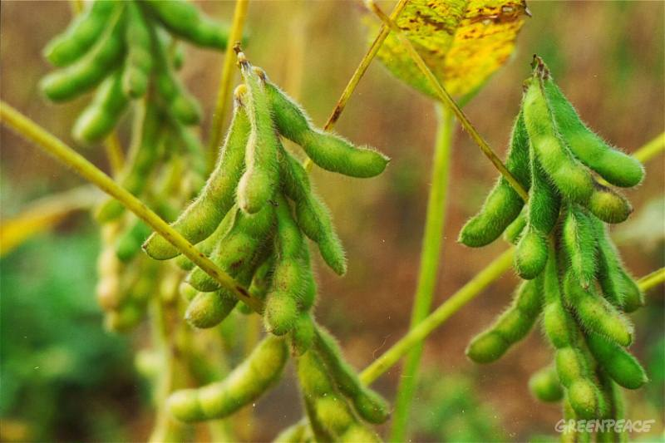
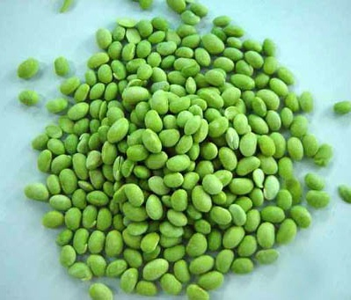
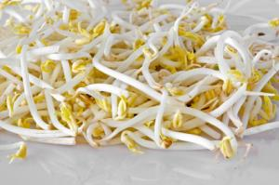
Soya beens contain all the essential Amino Acids (AA)

Slide 4
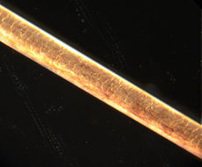
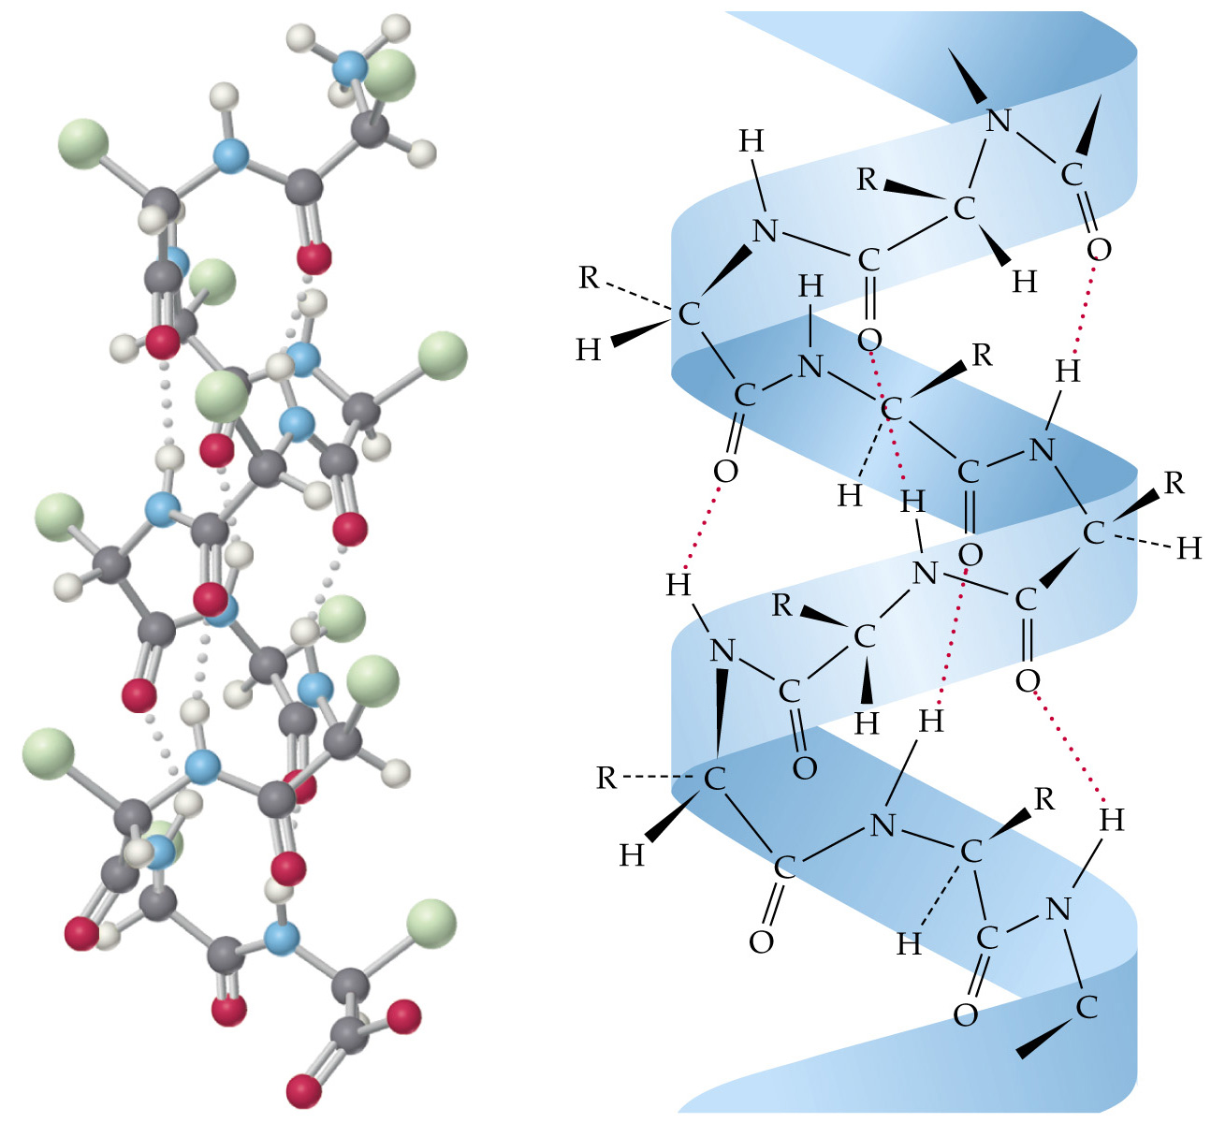
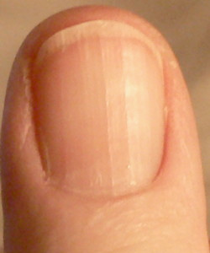
Structural Proteins: Example Keratin
Hair
Molecular structure of Keratin
Fingernail
Notes:
Structural proteins confer stiffness and rigidity to otherwise-fluid biological components.
Instructions to build this protein is stored in the DNA.

Slide 5
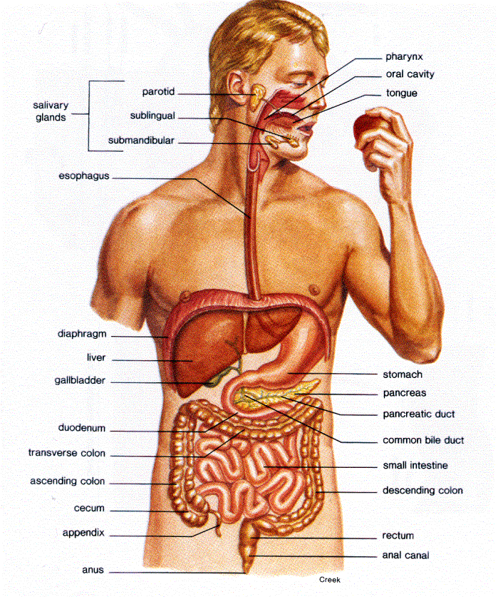
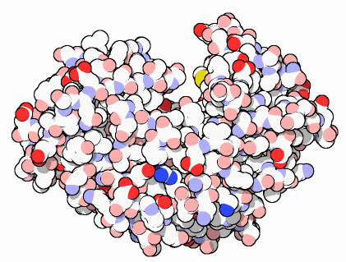
Proteins that control of Chemical Reactions: Enzymes
Digestive Enzyme in the stomach
Example: Pepsin
Notes:
Photosynthesis/ Respiration other examples

Slide 6
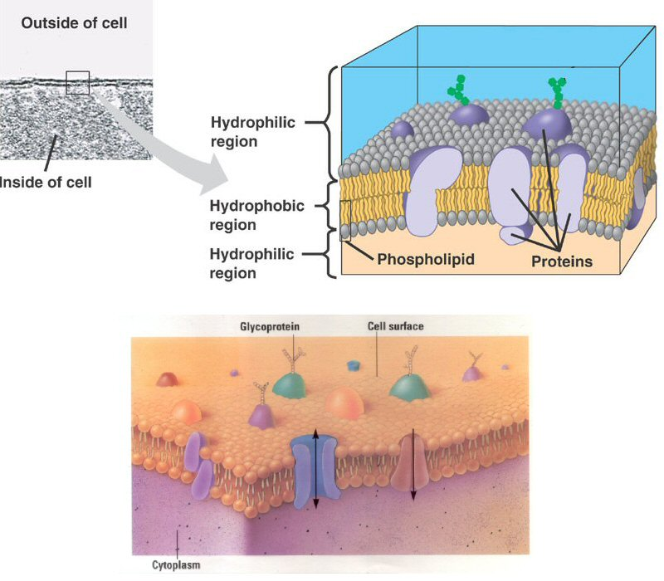
Cell Membrane Proteins:
→ Control of Transport into and out of the cell
Notes:
Cystic Fibrosis:

Slide 7
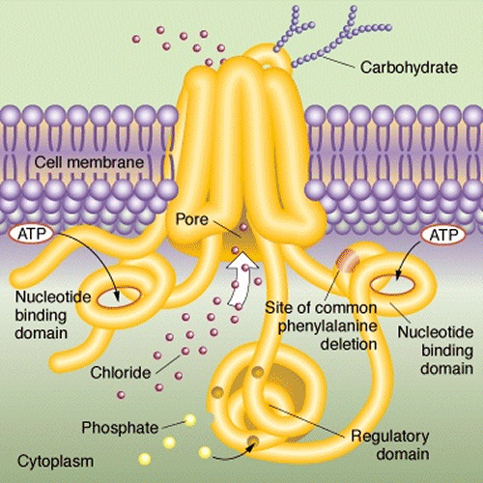
Example: Chlorid Channel

Slide 8
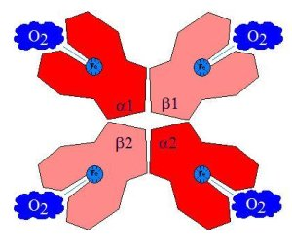
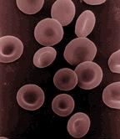
Transport Proteins:
Example: Haemoglobine
Red blood cell:

Slide 9
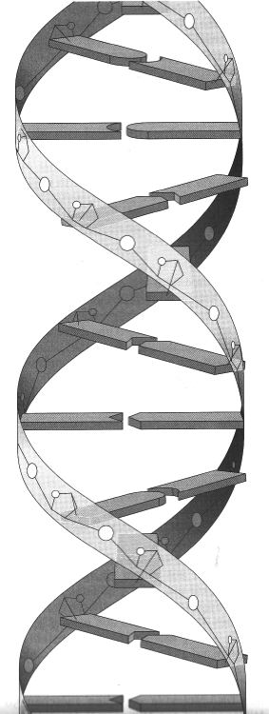
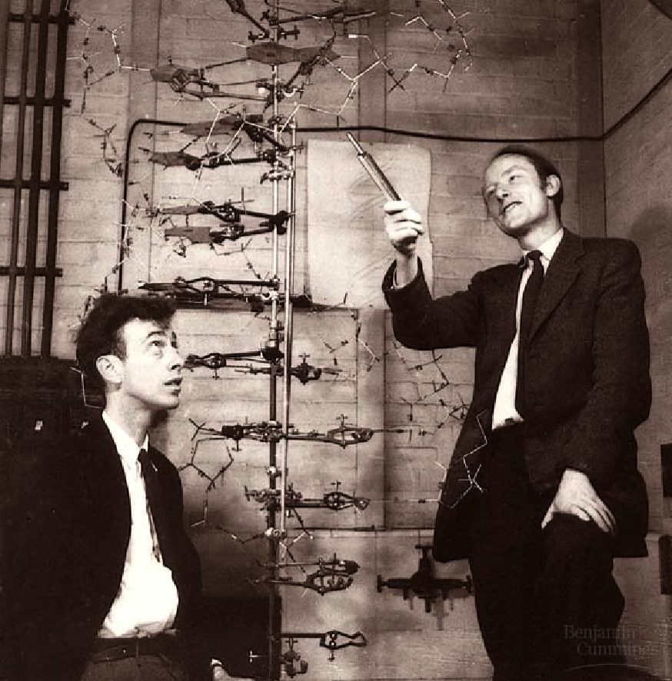
DNA
„Double Helix“
Watson and Crick 1953
→ Nobelprice in medicine

Slide 10
DNA

Slide 11
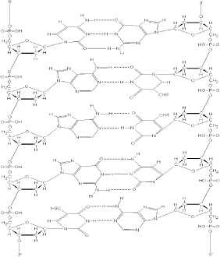
DNA: The molecule of life
5’ 3’
5’
3’

Slide 13
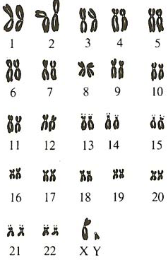
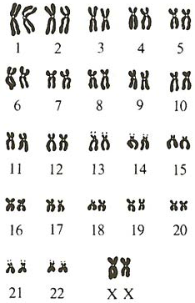
The 46 human Chromosomes
male
female

Slide 14
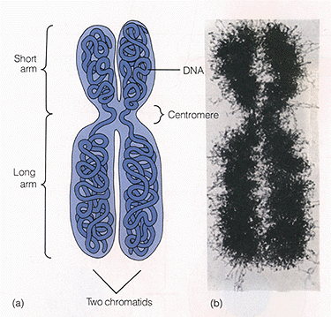
1 Chromosome

Slide 15
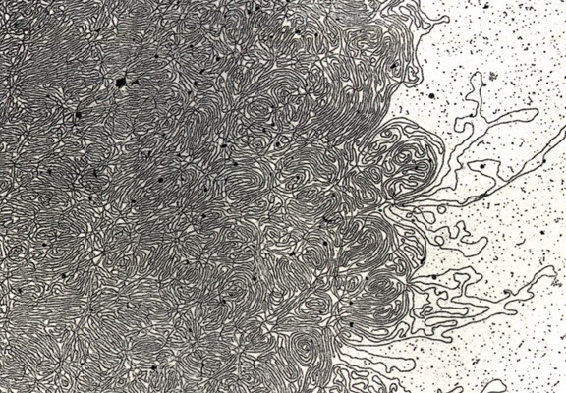
DNA- string

